Slide 1
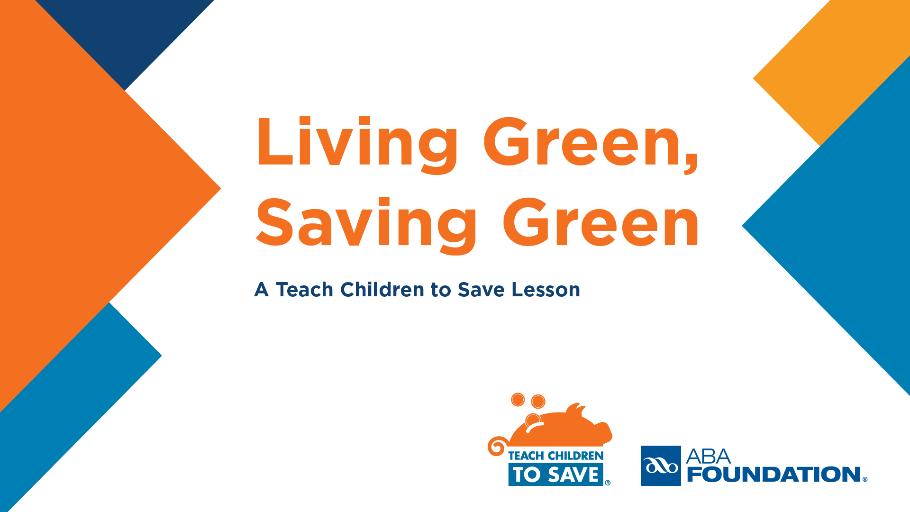
Notes:
Introduce yourself to the class. Say, “Hello. My name is Ms./Mrs./Mx./Mr.”
(Students generally address adults in school settings as Ms./Mrs./Mx./Mr. Most use their last name.)
Say, “I’m here today as a volunteer from (Bank Name). Today we’re going to talk about making choices.”

Slide 2

What is a choice?
Notes:
Ask, “Who can tell me what a choice is?”
Accept several student answers. Wait for responses.

Slide 3

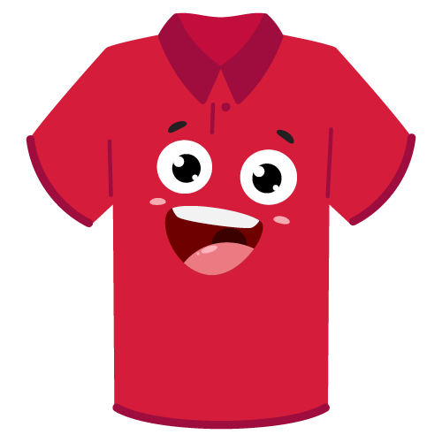
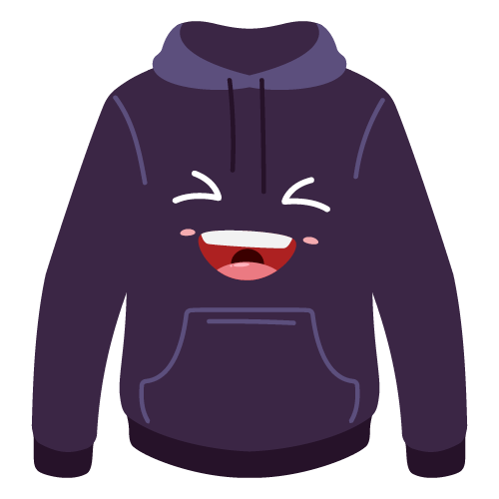

We make choices every day.
Notes:
If a correct answer is provided, say, “That’s right. Basically, a choice is when you make a decision about something. For example, when you got
up this morning, you had a choice, or a decision to make, about what to wear. You might have made a choice about what to eat for breakfast
or what to do with your hair.”
If not, say, “Well, a choice is when you make a decision about something. For example, when you got up this morning, you had a choice, or a
decision to make, about what to wear. You might have made a choice about what to eat for breakfast or what to do with your hair."

Slide 4

Share an example of a choice you made this morning.
Notes:
Say, “Raise your hand if you can give me an example of some other choices you had to make this morning.”
Call on 1 or 2 students to provide examples and acknowledge their responses. You can say:
• “Thank you! Great example!”
• “That’s definitely an example of a choice!”
• “I bet that was a hard/easy choice to make.”
Direct students to turn to a neighbor and share a choice they made this morning or recently.
If desired, share an example of a choice you made before seeing them today.

Slide 5
Money Choices
Notes:
Say, “I have some other choices for us to talk about today. These are choices about how to spend money.”
Ask, “Does anyone here like to spend money?” Smile and acknowledge student responses.
Say, “I like spending money, too. It is important, though, to think about our choices when we spend money.”

Slide 6

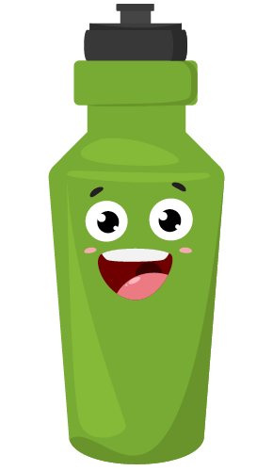
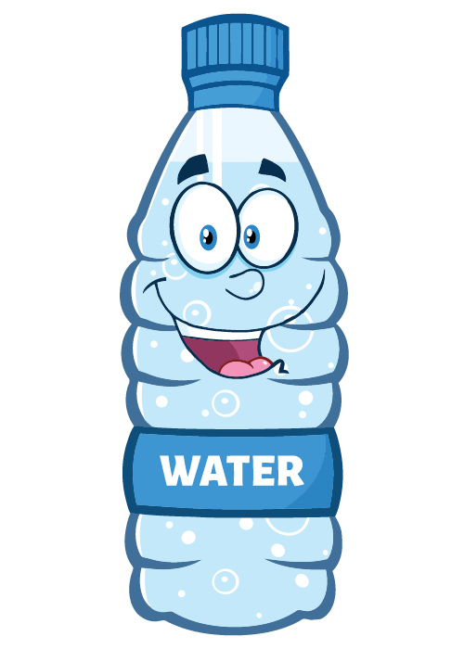
Going for a walk
Notes:
Say, “Here’s an example. Let’s say I’m going to go out for a walk when I get home. I might want to have water with me in case I get thirsty.”
Say, “I could buy a bottle of water like this.”
Click to animate the slide.
Hold up a single-use water bottle, if available.
Say, “This type of water bottle is convenient. I can buy these at the store and keep them in my refrigerator so they are cold before I go on a
walk. I can buy them in big packs or 1 at a time.”
Click again to animate the slide.
Hold up a reusable water bottle, if available.
Say, “Or, I could buy 1 of these and refill it from the refrigerator or tap every time I want water."

Slide 7

Cost comparison
Notes:
Say, “Let’s think about this decision a little more. If a pack of water costs about the same as a refillable bottle, I’m spending about the same
amount.”
Say, “But what happens when I run out of these throwaway bottles?”
Hold up the disposable bottle again.
Say, “I have to buy more, that’s right. So really, I’m spending more. Not only that, what happens to all these bottles after I use them?”
Wait for student responses

Slide 8



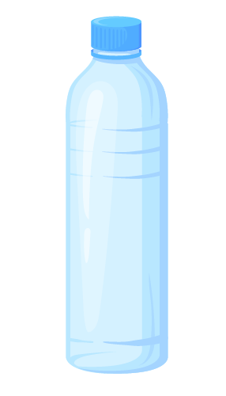

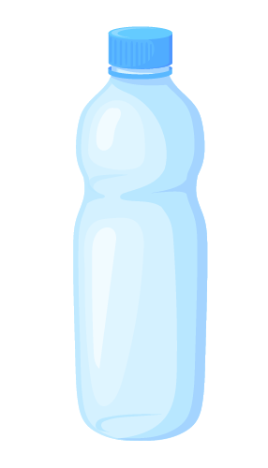



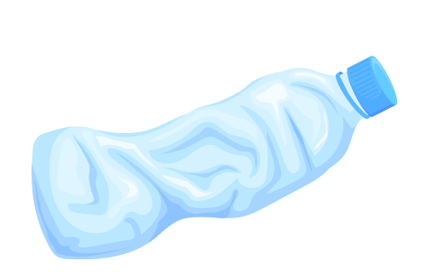
What happens?
Notes:
Say, “You’re right. They get thrown away in the trash or, if we’re lucky, they get recycled.”
Gesture to the reusable water bottle and say, “I can use this bottle over and over and over. It doesn’t get thrown away. I need to wash it, but I can
use it as many times as I want."

Slide 9
Which would
you choose?
Notes:
Say, “Knowing everything we do now, raise your hand if you think it is a better choice to refill this bottle every time.”

Slide 10

Reusing bottles saves money.
Notes:
Once students raise their hands, say, “Great decision. You just saved us money. I’m going to put 10 pennies in the bottle to show that we saved
money making that decision.”
Put 10 pennies in the reusable bottle, if available.

Slide 11
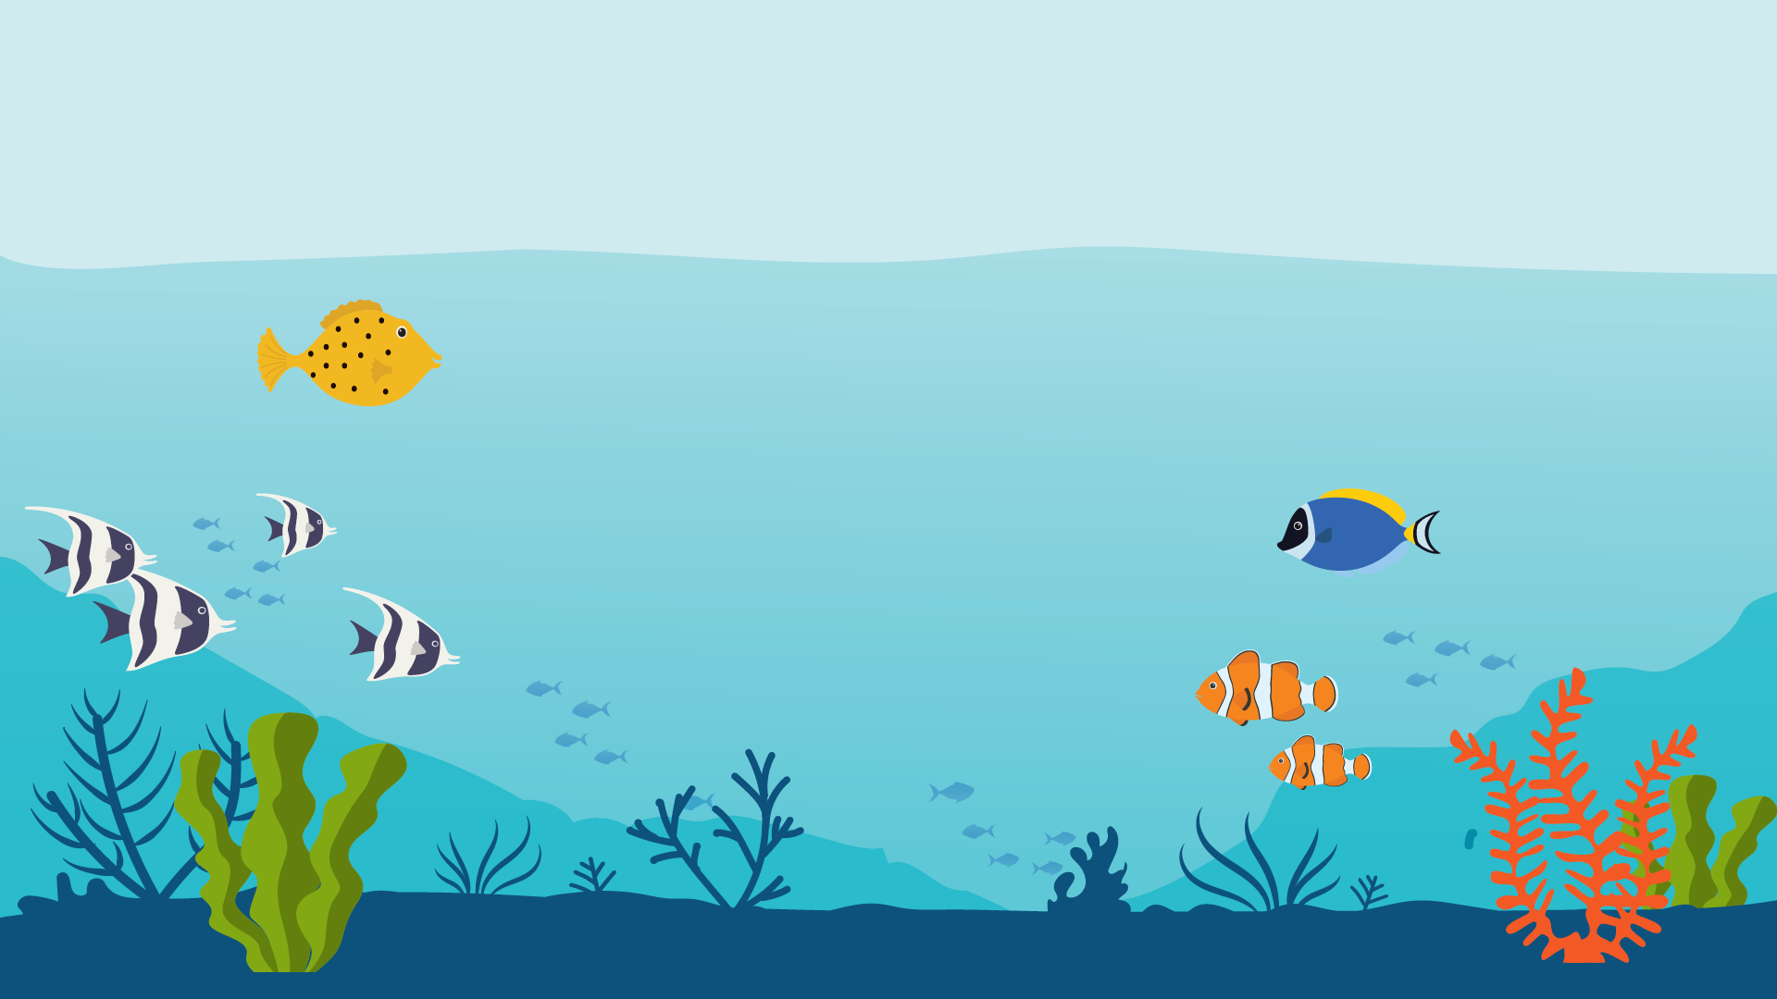
It is also better for our planet!
Notes:
Say, “You also just helped the planet. Reusing your own bottle helps keep lots of these (hold up disposable bottle) from being thrown away."

Slide 12
Our choice
Notes:
Say, “Now, every time you make a choice, you are picking 1 thing and giving up another.”
Say, “In this example, we chose the reusable water bottle.”

Slide 13
Our opportunity cost
Notes:
Say, “What we didn’t choose was the water bottle we could only use 1 time.”
Say, “When we make a choice, whatever we don’t choose has a special name. It is called the opportunity cost.”
Ask, “Can you all say that term with me?”
Say, “Opportunity Cost. Let’s say it once more to help us remember it. Opportunity cost.”
Congratulate the students for listening and repeating the term

Slide 14
Choices, Choices
Notes:
If desired, distribute a copy of the Choices, Choices activity sheet to each student.
Say, “Let’s take a look at some more choices and figure out which choices can save us money and help the environment."

Slide 15

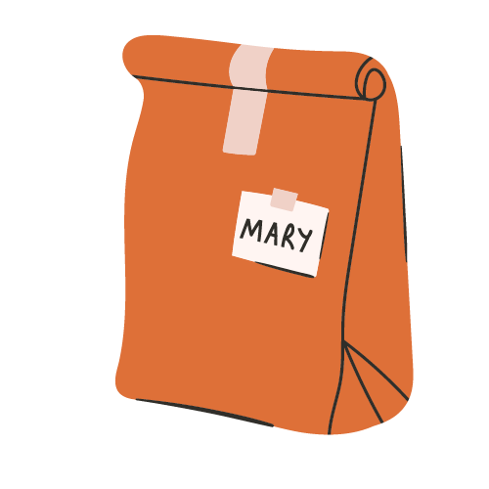
lunch box
paper bag
Notes:
Say, “First, we need to choose between bringing our lunch to school in a paper bag or using a lunch box.”
Ask, “Which choice do you think will save money over time and help the environment?”
Ask, “Who would pick the lunch box?”
Select a student and ask them to explain their answer.

Slide 16
lunch box
paper bag
Notes:
Explain the correct answer by saying, “Lunch bags are made of paper which comes from trees. If you use fewer paper lunch bags you can save
trees and save money.”
If demonstrating savings with pennies in the bottle, say, “We just saved more money. Let’s put 10 more pennies in the bottle. Now we have 20
pennies in the bottle.”
Put 10 more pennies in the bottle.

Slide 17
lunch box
paper bag
Notes:
Say, “Remember, I said the ‘opportunity cost’ in a decision is what isn’t chosen.”
Ask, “What is our opportunity cost with this choice?”
Wait for responses: the paper lunch bags.
If using the Choices, Choices Student Activity Sheets, make sure students circle the lunch box and put an X on the paper bag.

Slide 18
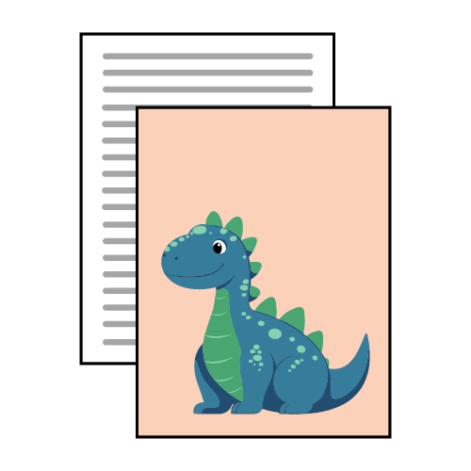
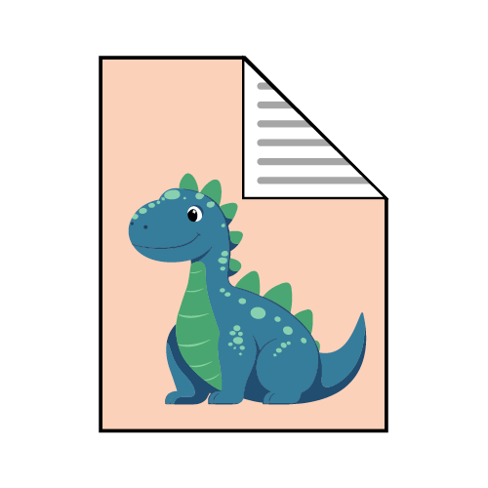
both sides
1 side
Notes:
Say, “Our second example is a choice between using both sides of a piece of paper or 1 side.”
Ask, “Which choice do you think saves money and helps the environment?”
If using the activity sheets, direct students to circle the choice and put an X on the opportunity cost. If not, say, “Turn to a neighbor and compare your
answers.

Slide 19
both sides
1 side
Notes:
Explain the money-saving answer by saying, “Using both sides of a piece of paper means you use half as much paper. That is good for the
environment and means you only have to buy half as much.”

Slide 20
both sides
1 side
Notes:
Say, “The opportunity cost is using 1 side of 2 sheets of paper.”
If using the pennies and water bottle, say, “We saved money again, let’s put 10 more pennies in the bottle. Now we have 30 pennies in the
Bottle.”
Put 10 more pennies in the bottle.

Slide 21

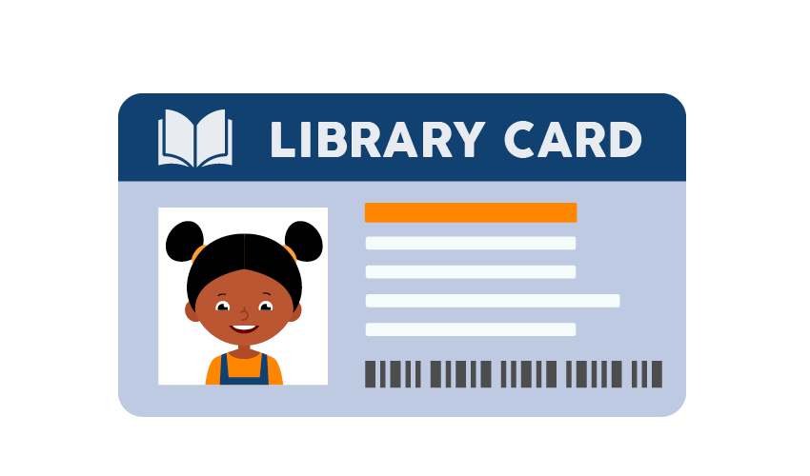
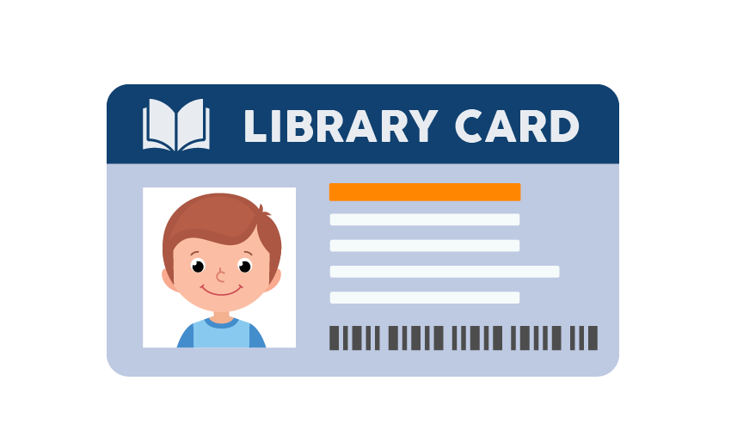
bookstore
library
Notes:
Ask, “What do you think the choice is in this third example?”
Say, “You can buy a new book at the store or check it out from a library free of charge. Then you bring it back so someone else can check it
out."

Slide 22
bookstore
library
Notes:
Explain the money-saving answer by saying, “Getting books from the library is free. When many people use the same book, that means fewer
books need to be made, saving paper and trees.”
If using the pennies and water bottle, say, “We saved money again, let’s put 10 more pennies in the bottle. Now we have 40 pennies in the
bottle.”
Put 10 more pennies in the bottle

Slide 23
bookstore
library
Notes:
Say, “The opportunity cost in this case is buying a new book from the bookstore."

Slide 24
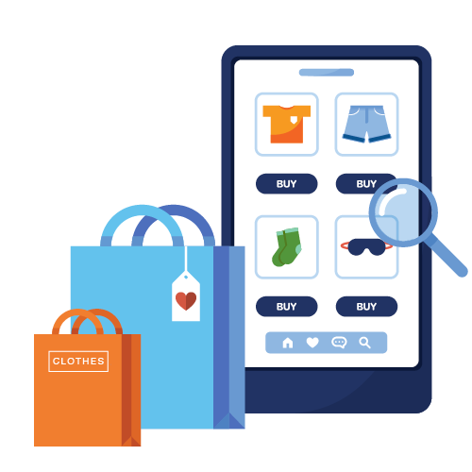
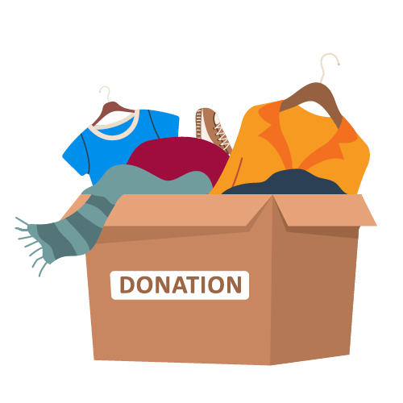
new
used
Notes:
Say, “Let’s look at our last example.”
Ask, “Which choice is likely to save money and help the planet — buying something that is new or buying something that someone else has
used before?”

Slide 25
new
used
Notes:
Explain the money-saving answer by saying, “Buying things that are new usually costs more money than buying items that have been used
before. You might find used items in a thrift shop, yard sale, or donation center. Some people like to call these ‘second-hand’ items, or say
they are ‘new to me.’”
Say, “By reusing something that another person no longer wants or needs, you are saving it from being sent to a landfill and reducing the
number of new items that need to be made.”
If using the pennies and water bottle, say, “Great job! We saved money again, let’s put 10 more pennies in the bottle. Now we have 50 pennies in
the bottle.”
Put 10 more pennies in the bottle

Slide 26
new
used
Notes:
Say, “The opportunity cost in this case is not being able to buy the new item."

Slide 27
Notes:
Say, “Now, it is great if 1 person makes these choices. It saves them money and helps the environment. What if another person made
similar choices?”
Click to animate the slide.
Say, “As more people make money-saving and planethelping choices, the impact grows and grows.”
If using the pennies and water bottle:
Say, “With just 1 person, we added a total of 50 pennies to the bottle. Let’s put another 50 cents in the bottle for this second person making
money-saving choices.” Break open a penny wrapper and put all 50 cents in the bottle or ask a student to do this for you.
Say, “That’s 100 pennies now. If we have another person do it, we’ll have 150 pennies!” Have another student put 50 pennies in the bottle.
Repeat the process until the bottle looks fuller.

Slide 28
My Choices
Notes:
If time allows, invite students to share ideas of choices that save money and help the environment.
If desired, distribute the My Choices Activity Sheet, and direct them to draw their ideas.

Slide 29
My Choices
What other choices could save money AND help the environment?
?
?
?
?
?
?
?
?

Slide 30
What can you do with coins?
Notes:
If you used the pennies and water bottle,
Say, “I hope you remember the choices we discussed today. The bottle got filled with pennies pretty slowly when just 1 person was making
choices that saved money and the environment, didn’t it? But what happened when other people started doing the same thing? It started to
fill up faster.”
Say, “The same is true in the real world. It is good if each of us makes choices that save money and the environment, but it is even better if
we all do.”
If not,
Say, “Making 1 good choice is great. When you make more and others do, too, the impact gets even bigger — especially on the
environment and our planet.”

Slide 31

THANK YOU!
Notes:
Say, “Thank you for letting me come and talk to you today. I think it is really important for everyone to think about how they spend their
money. It makes a difference to them and to the environment. I hope you do too.”

