Slide 1

Unlocking Savings
A Teach Children to Save Lesson

Slide 2

Breakout or
Escape Room
Notes:
Ask, “Have you ever participated in a breakout or escape room activity before?”
Accept several student answers. If needed, explain that these activities involve solving puzzles and problems.
They typically involve a team of players working together to discover clues, solve puzzles, and accomplish tasks to escape a room or open a locked box.

Slide 3
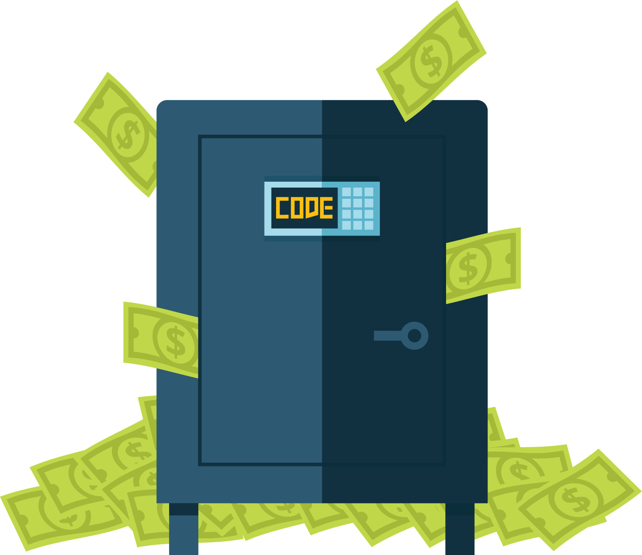
Unlocking
Savings
Notes:
Say, “The name of our breakout is called ‘Unlock Savings.’ Before we solve any problems, let’s see who we are helping.”

Slide 4
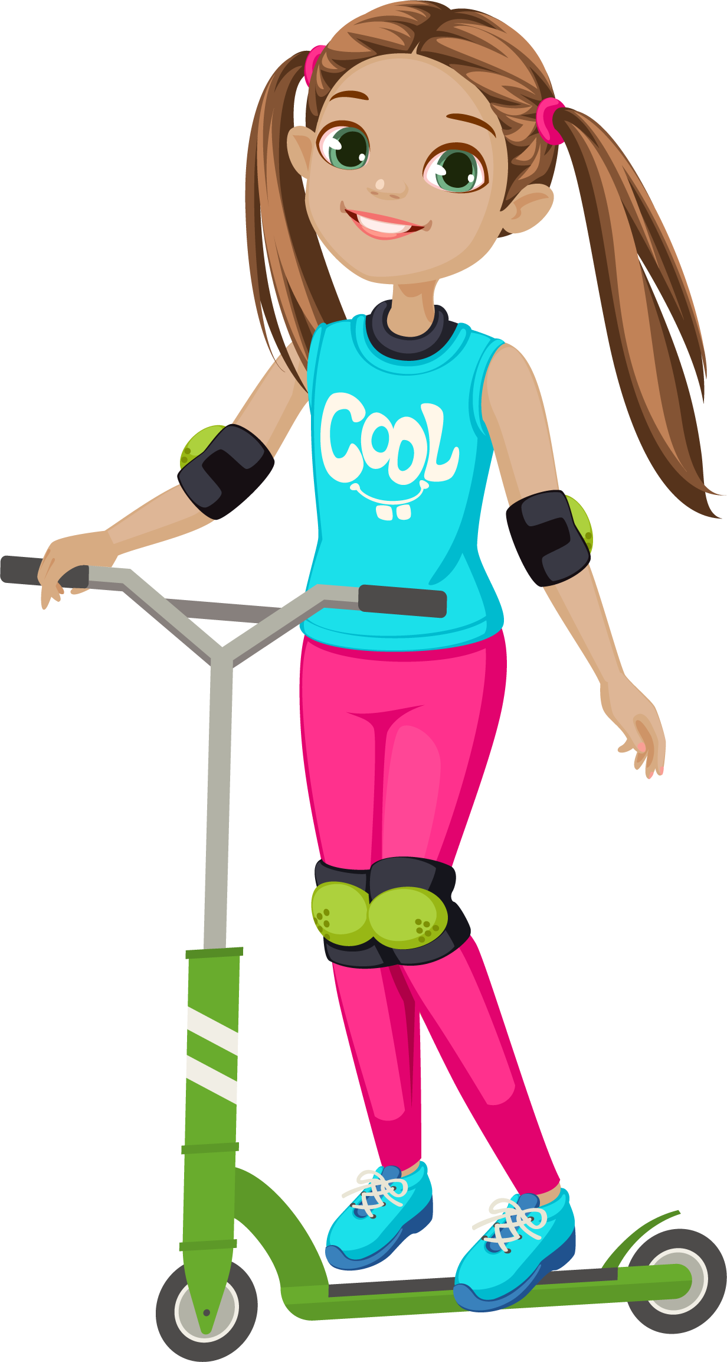
Meet Gabriella
Gabriella is a fourth grader at Downtown Elementary School. She’s one of the nicest kids you’ll ever meet! She is a great friend and is always happy. She loves animals and riding her scooter.
Notes:
Read, “Gabriella is a fourth grader at Downtown Elementary School. She’s one of the nicest kids you’ll ever meet! She is a great friend and is always happy. She loves animals and riding her scooter.”

Slide 5
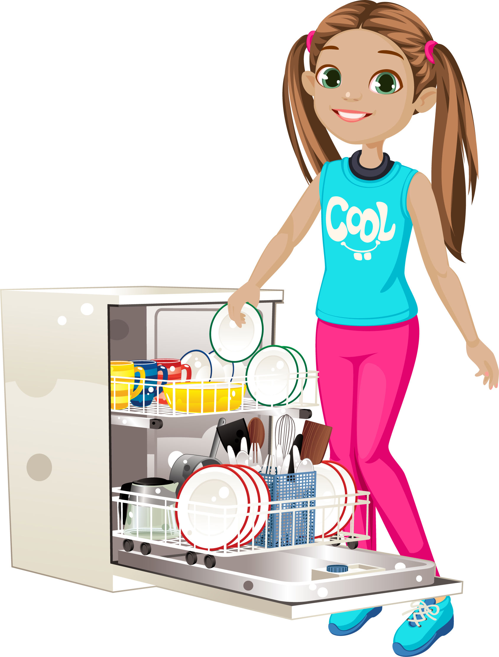
Gabriella Does Chores
Every week Gabriella does chores
at home. She makes her bed and
cleans her room. After dinner, she loads the dishwasher and wipes off
the table. On the weekends, she vacuums and helps fold the laundry.
Notes:
Read, “Every week Gabriella does chores at home. She makes her bed and cleans her room. After dinner, she loads the dishwasher and wipes off the table. On the weekends, she vacuums and helps fold the laundry.”
Ask, “Do any of you do chores at home?”
Acknowledge students’ answers. If desired, share a chore you were responsible for doing when you were their age.

Slide 6
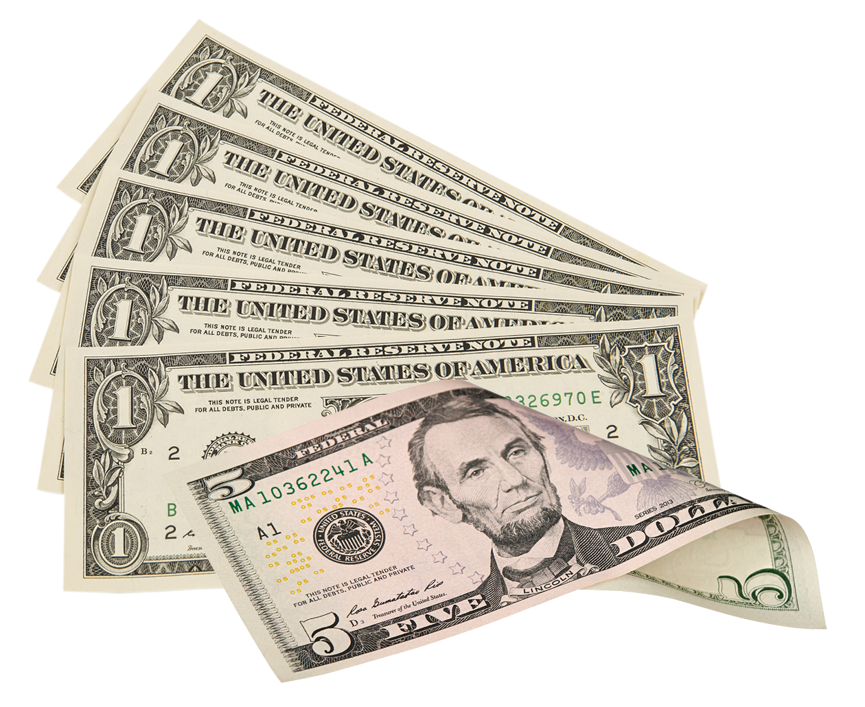
Allowance Time
When all of her chores are done for the week, Gabriella’s parents give her an allowance.
Notes:
Read, “When all of her chores are done for the week, Gabriella’s parents give her an allowance.”
Ask, “Who can tell me what an allowance is?”
Explain that an allowance is money children receive from their parents or guardians.
Some families pay their children an allowance and some do not.
Some children need to do chores for their allowance. Others do not.
Reinforce that every family handles allowances differently.

Slide 7


Gabriella’s Challenge
When Gabriella gets her allowance, she always thinks about saving some of it. She knows that saving money is a good idea, but she seems to end up spending it instead.
Notes:
Read, “When Gabriella gets her allowance, she always thinks about saving some of it. She knows that saving money is a good idea, but she seems to end up spending it instead.”

Slide 8
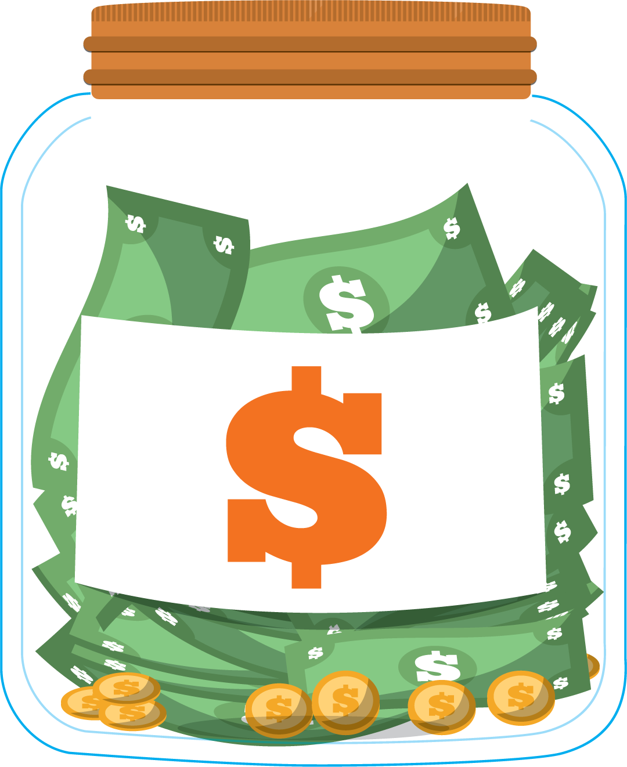
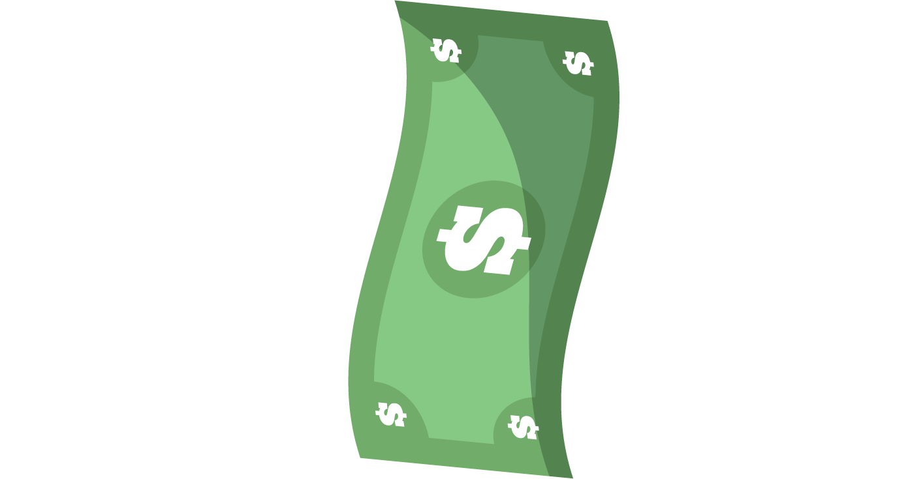
Are you more of a
Saver?
or a
Spender?
1
2
Notes:
Ask, “Do you think of yourself as more of a saver or a spender?
Say, “Hold up one finger if you are more of a saver or two fingers if you think you are more of a spender.”
Comment on student responses, by saying, “I see most of you think of yourselves as savers,” or
“It looks like we have a pretty good mix of savers and spenders in this group.”

Slide 9
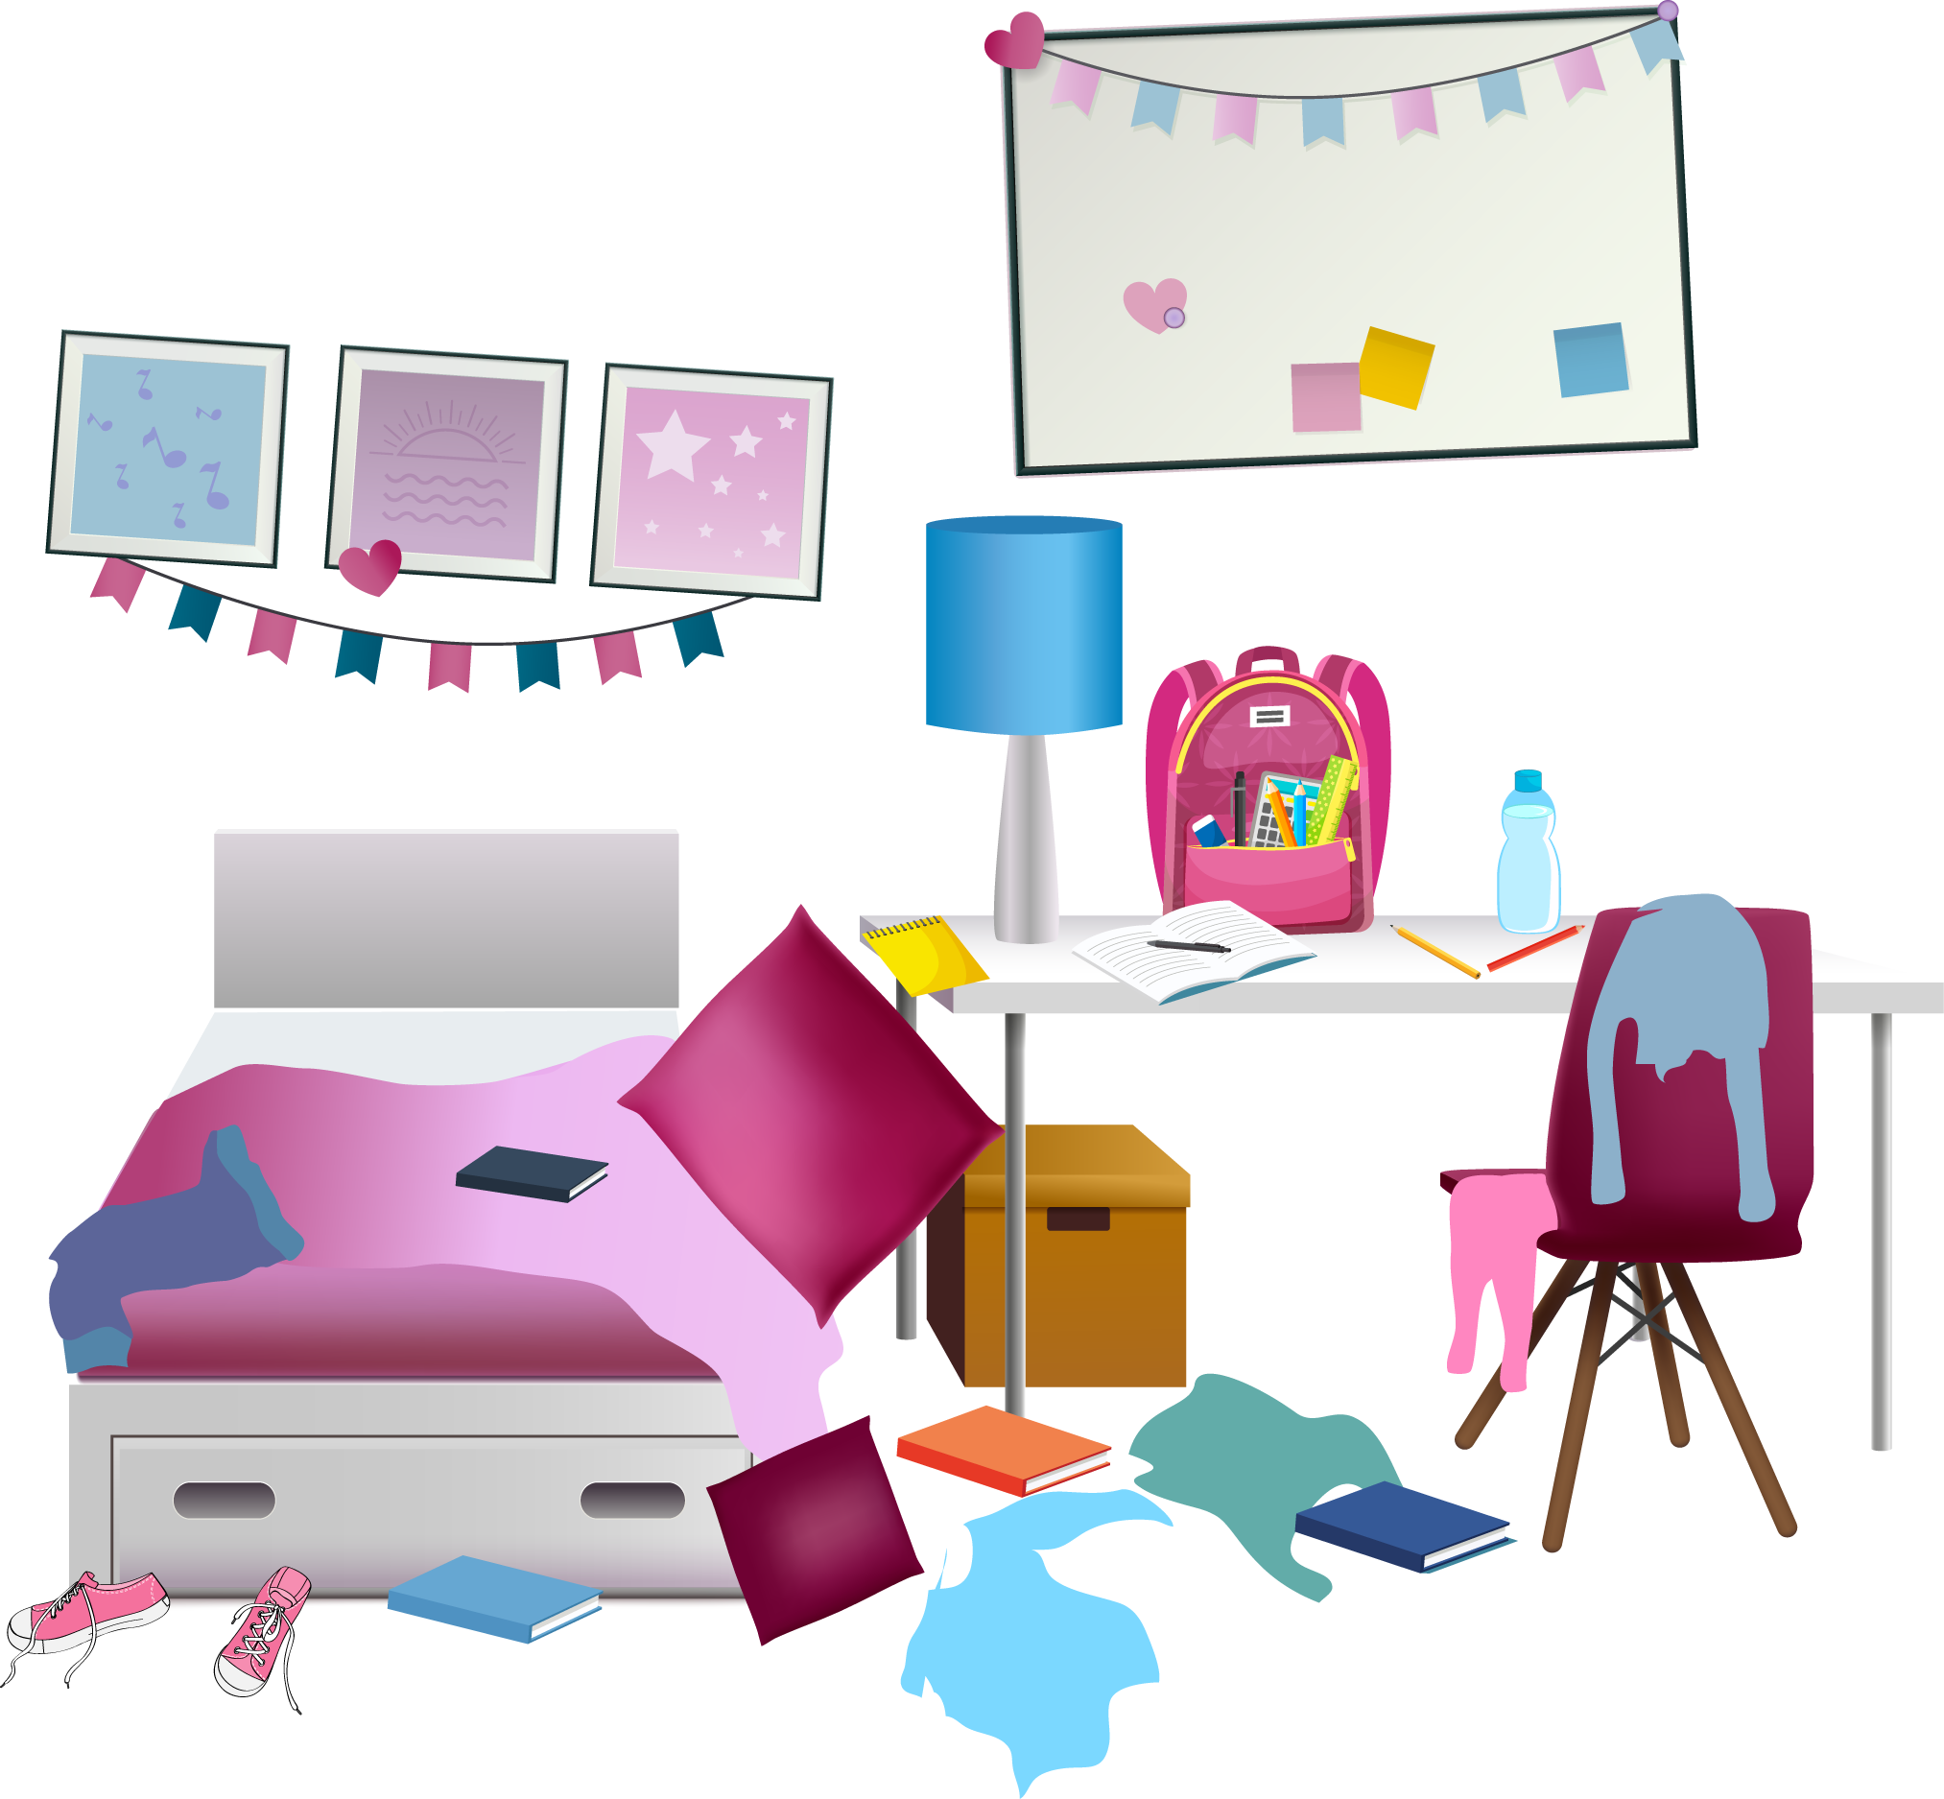
Help Gabriella
Gabriella needs our help to become a better saver! To start, can you help Gabriella find her piggy bank? Her room is a mess.
Notes:
Read, “Gabriella needs our help to become a better saver! To start, can you help Gabriella find her piggy bank? Her room is a mess.”

Slide 10
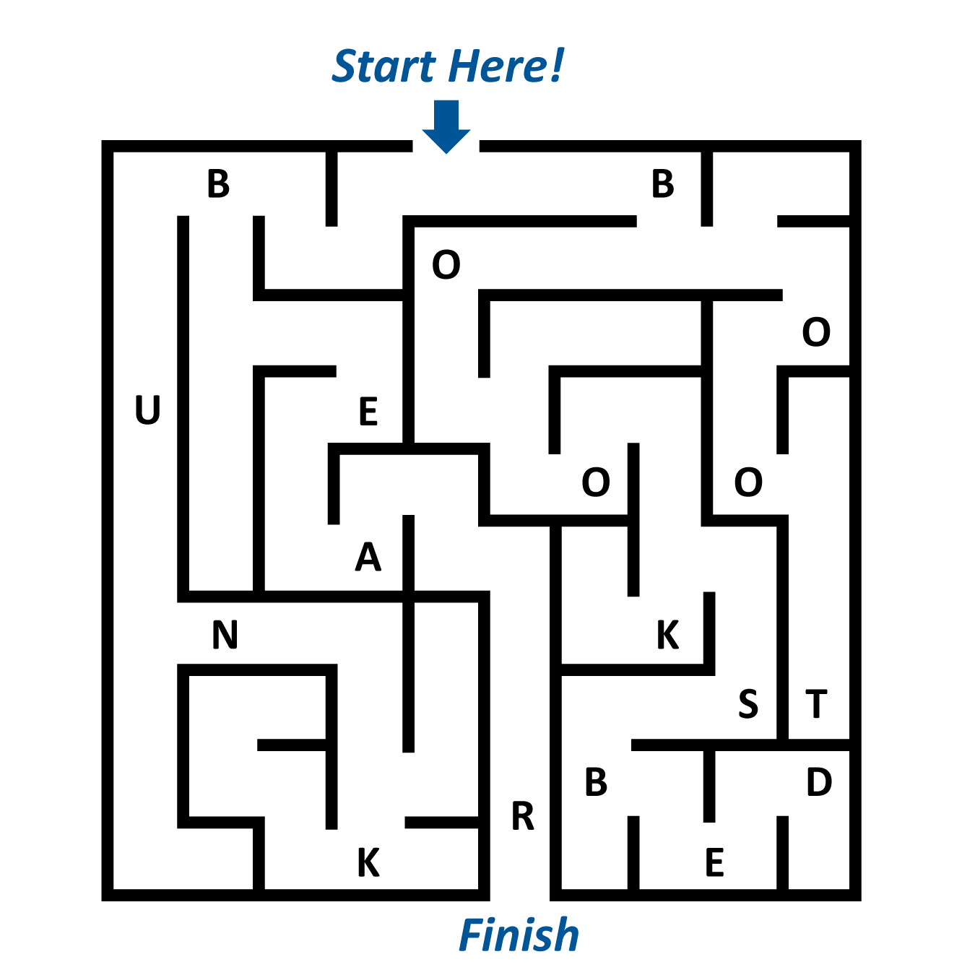
Find the Piggy Bank
Solve the maze to spell where her piggy bank is hiding!
Notes:
Say, “We need to solve the maze to spell where her piggy bank is hiding.”
Call on a volunteer to come to the front and help solve the maze, or direct students to work with a partner to solve it.
If needed, let them know the solution is the series of letters along the answer’s path.

Slide 11

Will your solution work?
Notes:
Ask, “Think we can open this lock?”
Determine which solution you will try:
• Use what the volunteer provides.
• Call on a pair of students to share their answer.
• Gather responses from the class, and take a vote for the best answer.
Try the selected solution. If needed, try others until the correct one is used (BEAR).

Slide 12
Well done!
Notes:
Confirm the answer is correct and compliment the students on solving the clues.

Slide 13
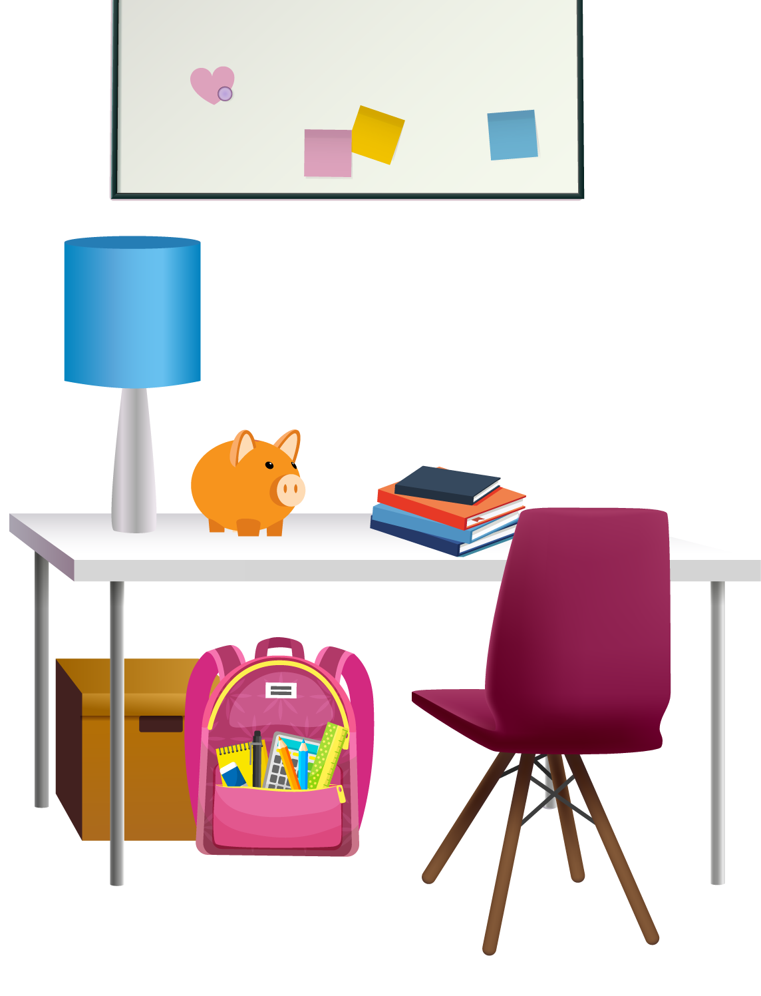
Piggy Bank Found
Congratulations! You helped Gabriella find her piggy bank! If Gabriella can easily see her piggy bank, she will have an easier time adding money to it when she earns her allowance.
Notes:
Read, “Congratulations! You helped Gabriella find her piggy bank! If Gabriella can easily see her piggy bank, she will have an easier time adding money to it when she earns her allowance.”
Say, “Some people might ask where you keep your money at home, but I will not. Does anyone have a guess about why I won’t ask you that?”
Explain that where you keep your money is private information and only the people who need to know that information should have it. Not sharing where our money is kept helps to keep it safe.

Slide 14
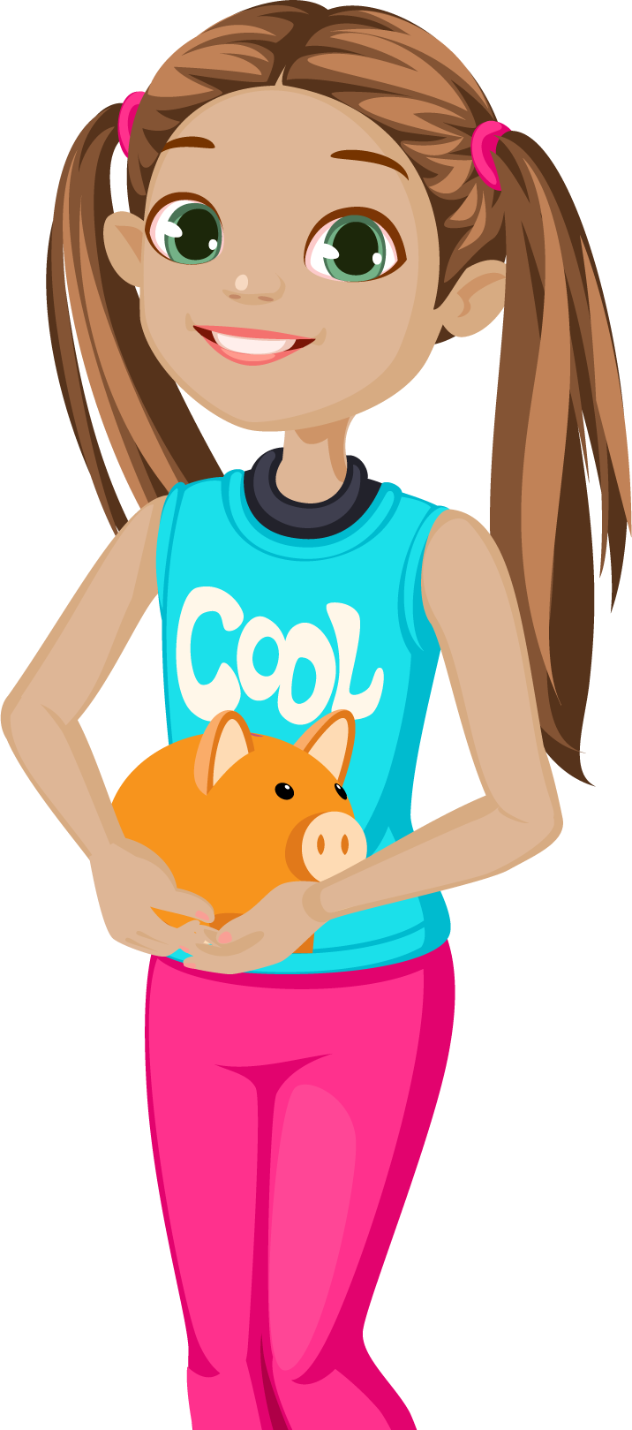
Bank Her Savings
If Gabriella wants to keep her money extra safe, she should take it to the bank and deposit it in a savings account.
Notes:
Read, “If Gabriella wants to keep her money extra safe, she should take it to the bank and deposit it in a savings account.”
Say, “Let’s make sure everyone knows what this means. A savings account is an account offered at a bank. It keeps your money safe. You can also earn interest, which is money paid to savers for putting their money in the bank. Making a deposit means you are putting money into the account. The opposite of a deposit is called a withdrawal — meaning you remove money from your account.”
If desired, let students know that children are allowed to open savings accounts at your bank with the help of an adult.
Share the minimum deposit amount for a child’s savings account and other requirements, if applicable

Slide 15
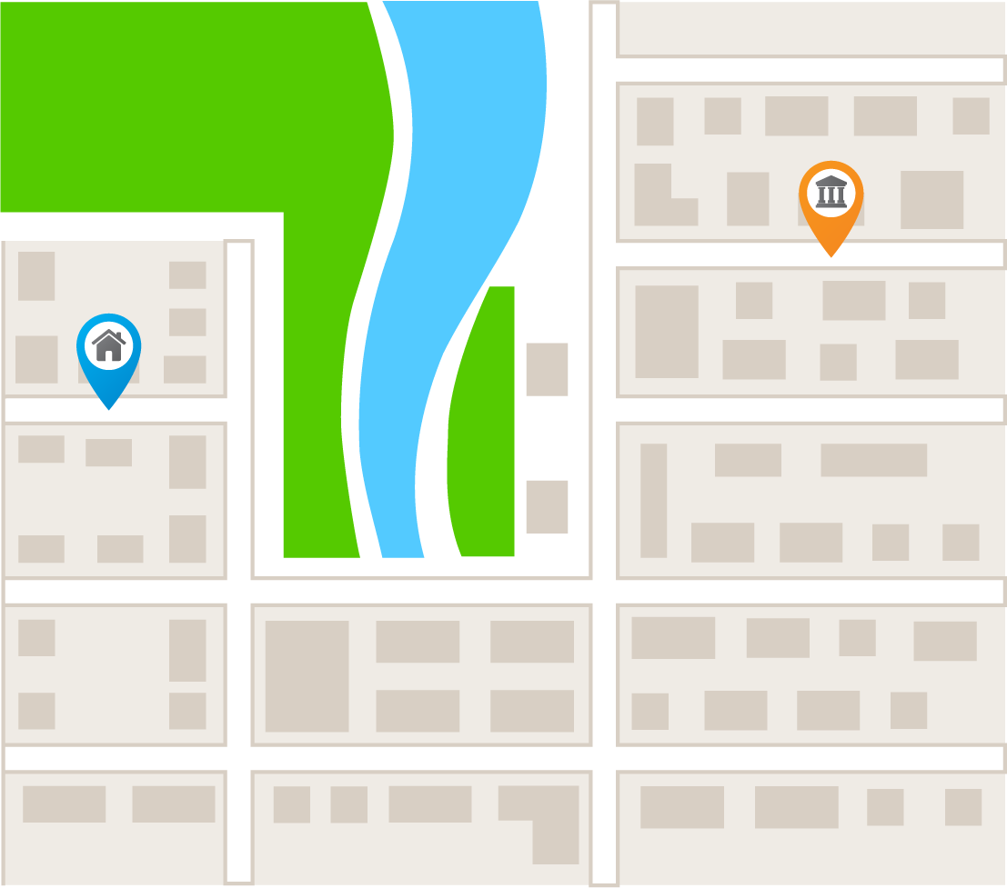
Get Gabriella to the Bank
Can you help Gabriella find the bank? Keep track of the way Gabriella needs to go on the map in order to get to the bank.
Notes:
Read, “Can you help Gabriella find the bank? Keep track of the way Gabriella needs to go on the map in order to get to the bank.”
Call on a student to solve the maze. As the solution is stated, follow the route on your computer with your cursor or trace the route on the screen with your finger.
Say, “Let’s retrace those steps and keep track of the directions we went: up, down, left, or right.”
Retrace the solution and ask students to help keep track of the direction each time. When their solution matches the solution below, move on to the next slide. If they offer a different solution, prompt them to choose the shortest possible route.
Solution: • Right • Down • Right • Up • Right

Slide 16
Will your solution work?
Notes:
Say, “Let’s see if your solution works.”
Click the slide to reveal each arrow, one at a time.
Use comments such as, “Looks like we are on the right path” and “This is looking good” and/or questions like “Is this the same route we took?”

Slide 17
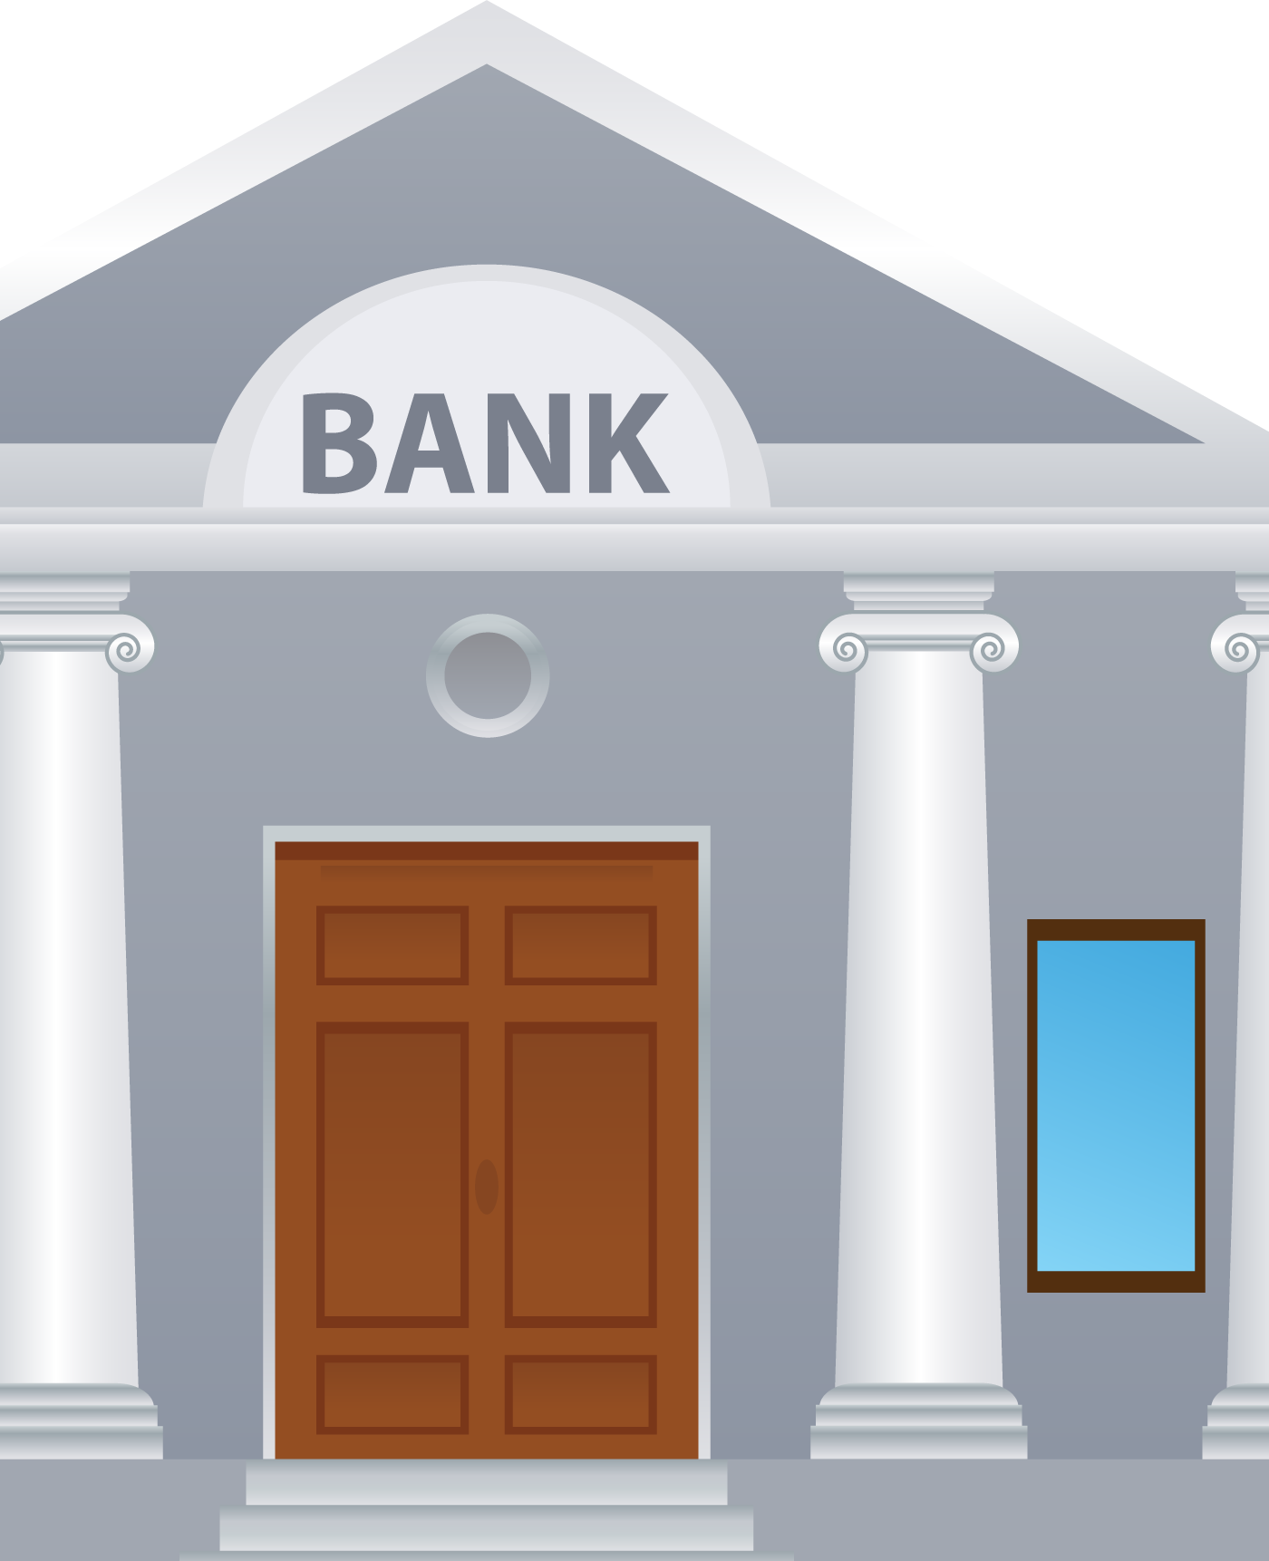
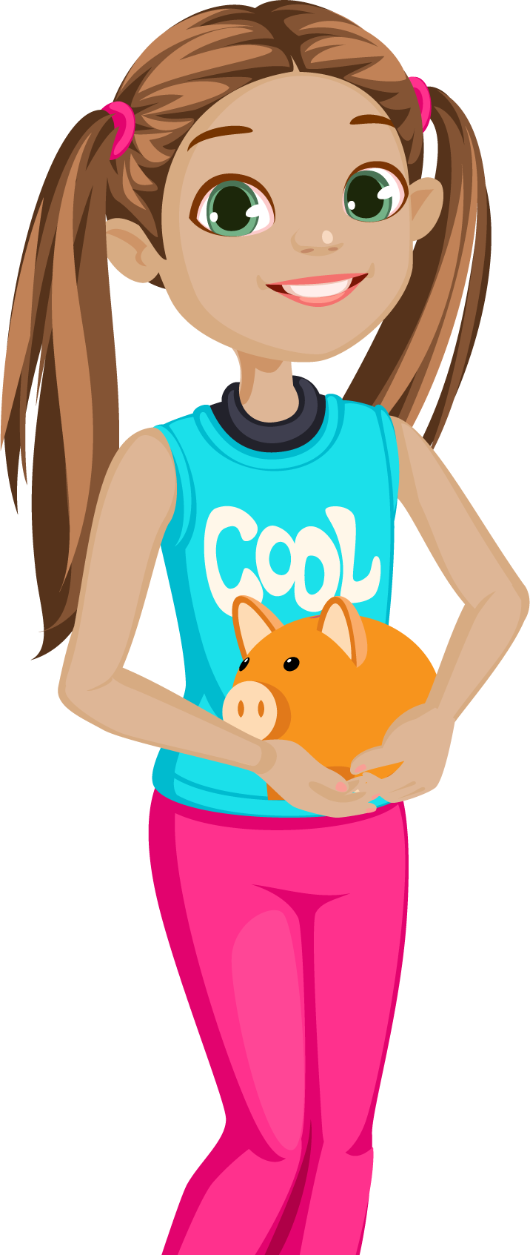
Money Deposited
Nice job! You helped Gabriella get to the bank
and deposit her money!
With her money in the
bank, she won’t be as tempted to spend it!
Notes:
Say, “Nice job! You helped Gabriella get to the bank and deposit her money! With her money in the bank, she won’t be as tempted to spend it!”
Remind students that there are a number of reasons to keep any money they are saving in a bank.
First, it is a very safe place to keep their money. Money that people deposit there is insured, meaning they cannot lose it.
Second, when their money is in a savings account it makes it a little more challenging to spend it. It isn’t impossible, but it takes a little effort.
This is especially helpful for people who have a hard time saving their money instead of spending it.

Slide 18
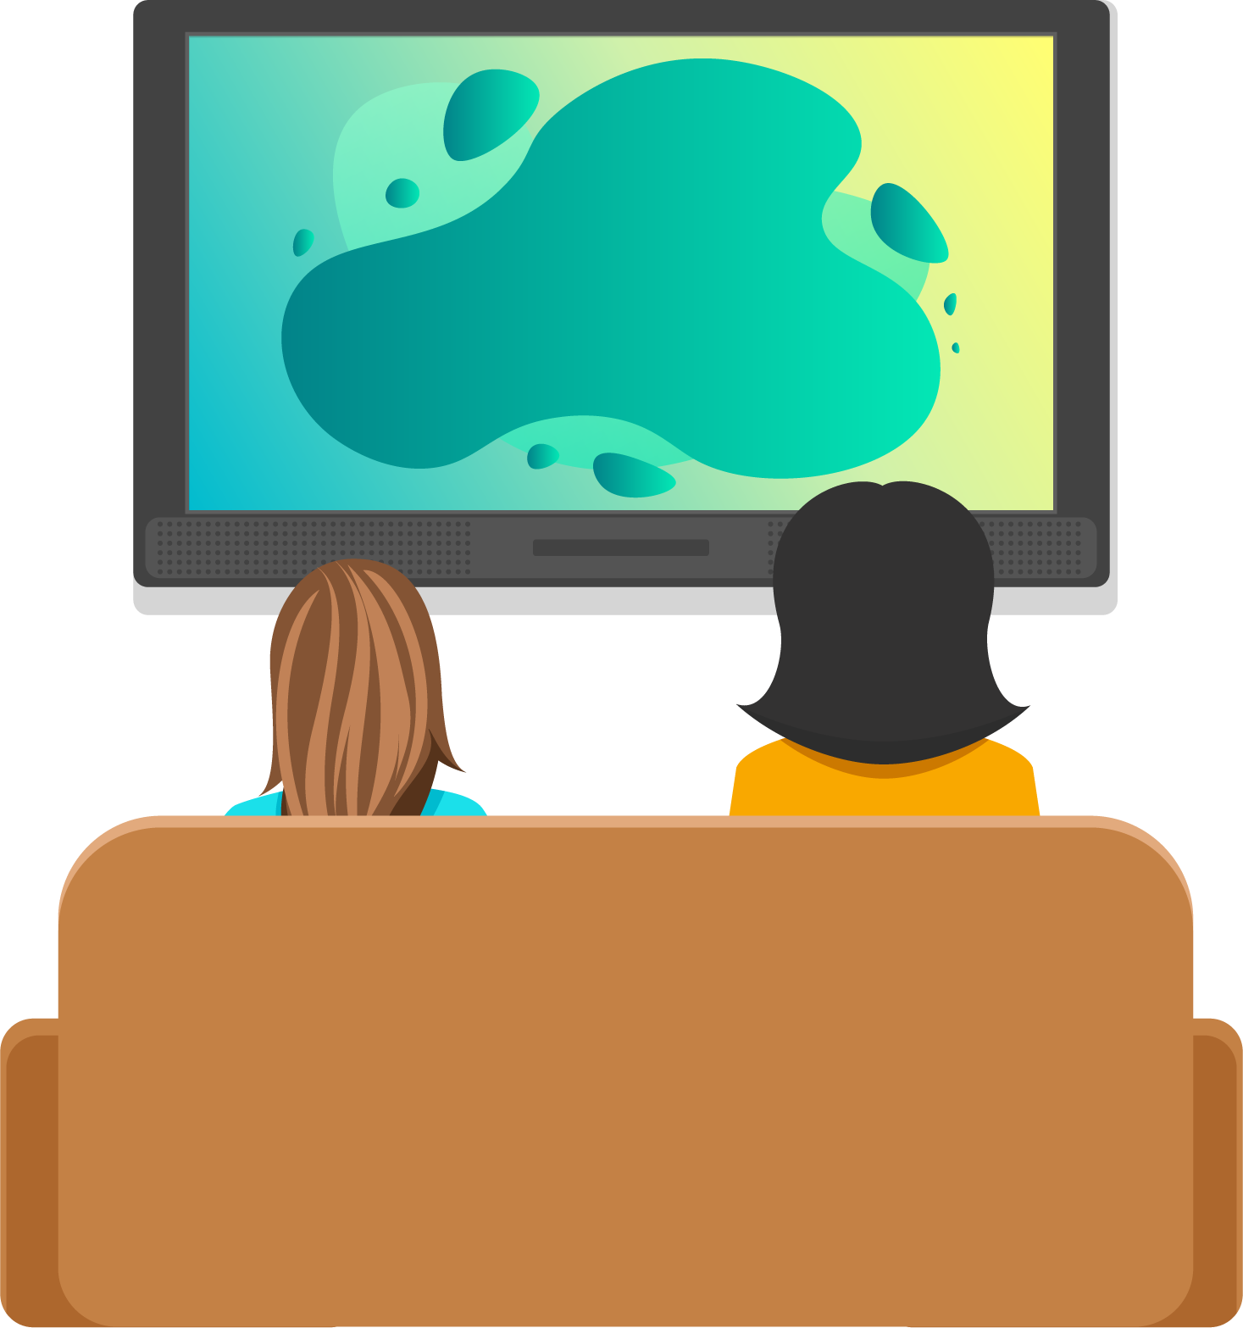
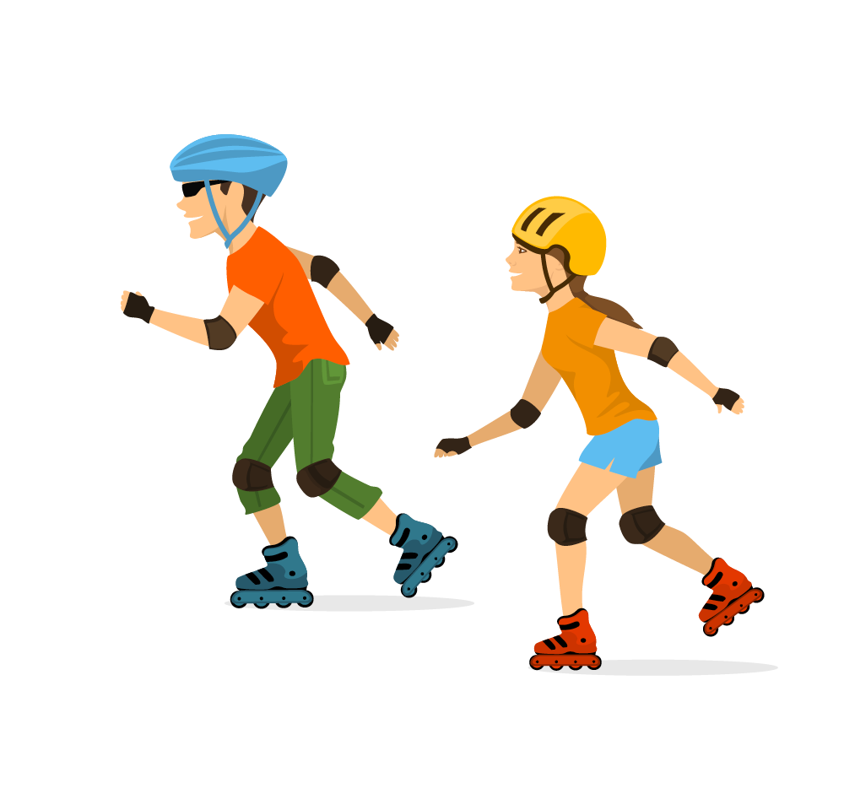
Savings Goal
Gabriella is watching a
show with her mom
when she gets an idea for something she really wants! Her mom says she should save her money to get it.
Notes:
Say, “Gabriella is watching a show with her mom when she gets an idea for something she really wants! Her mom says she should save her money to get it.“
Invite students to share if they have ever saved money to buy something or pay for a certain experience.
Consider sharing a personal example of something you have saved money for in the past or are saving money for now.

Slide 19
Decode the Clues
bicycle pet turtle soccer ball electric scooter video game aquarium roller blades board game doll house parrot
Clue One: Ends in a consonant
Clue Two: Has two words
Clue Three: Has twice as many consonants as vowels
Notes:
Say, “This is a list of possible items that Gabriella is saving to purchase. I’m going to show you three clues.
When you think you know what Gabriella is saving for, raise your hand.”
Click to animate the slide. Read, “Clue one: Ends in a consonant.”
If needed, remind students that some letters are vowels (for example, a, e, i, o, and u), and the rest are considered consonants.
Pause for a moment while students eliminate choices.
Say, “Don’t be too quick to guess. You might not have quite enough information yet.” Click to animate the slide.
Read, “Clue two: Has two words.” Ask, “Are you narrowing it down?” Click to animate the slide.
Read, “Clue three: Has twice as many consonants as vowels.”

Slide 20
Is your solution correct?
bicycle pet turtle soccer ball electric scooter video game aquarium roller blades board game doll house parrot
Notes:
Ask, “Who thinks they know the answer?”
Call on a student to provide their answer. Congratulate the first student to share the correct answer: roller skates.

Slide 21
bicycle pet turtle soccer ball electric scooter video game aquarium roller blades board game doll house parrot
Clue One: Ends in a consonant
Clue Two: Has two words
Clue Three: Has twice as many consonants as vowels
Notes:
Say, “Let’s go through the clues again.”
Click to show Clue One, and read, “Ends in a consonant.”
Say, “That means we can rule out the choices that end in a vowel: A, E, I, O, or U.” Click to reveal the choices that are eliminated.
Click to show Clue Two. Read, “Has two words.” Say, “That eliminates the one-word choices.”
Click to reveal the choices that are eliminated. Say, “That leaves us with: soccer ball, electric scooter, and roller blades.”
Click to show Clue Three. Read, “Has twice as many consonants as vowels.”
Ask, “How many consonants and vowels are in each of our remaining options?”
The correct answer is:
• Soccer ball: 7 consonants and 3 vowels
• Electric scooter: 9 consonants and 6 vowels
• Roller blades: 8 consonants and 4 vowels, and 8 is double 4
Click to reveal the choices that are eliminated and the final answer: roller blades.

Slide 22
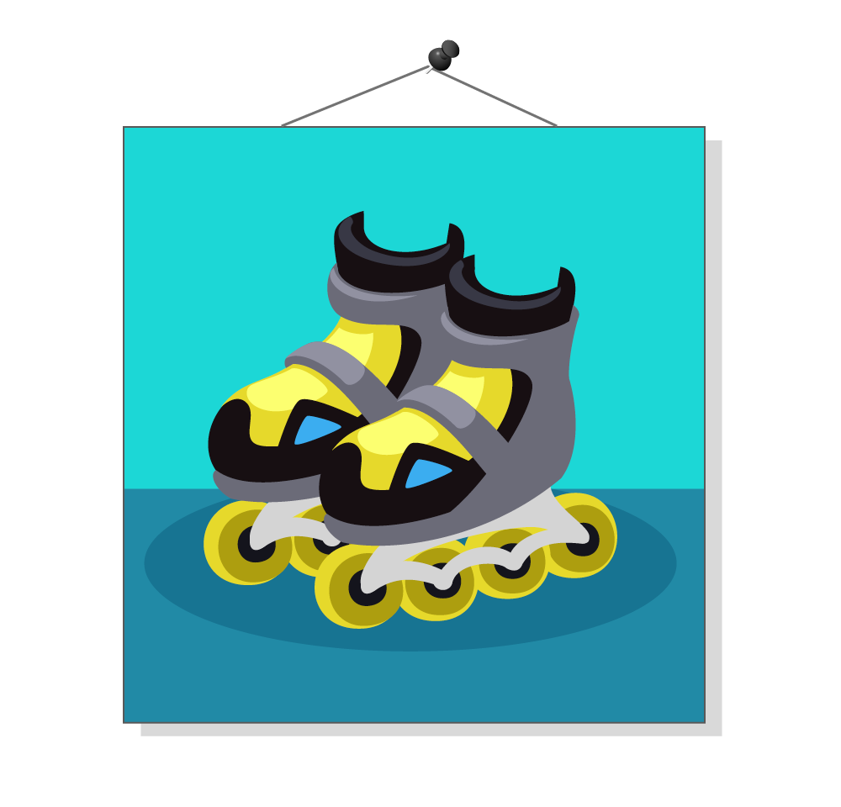
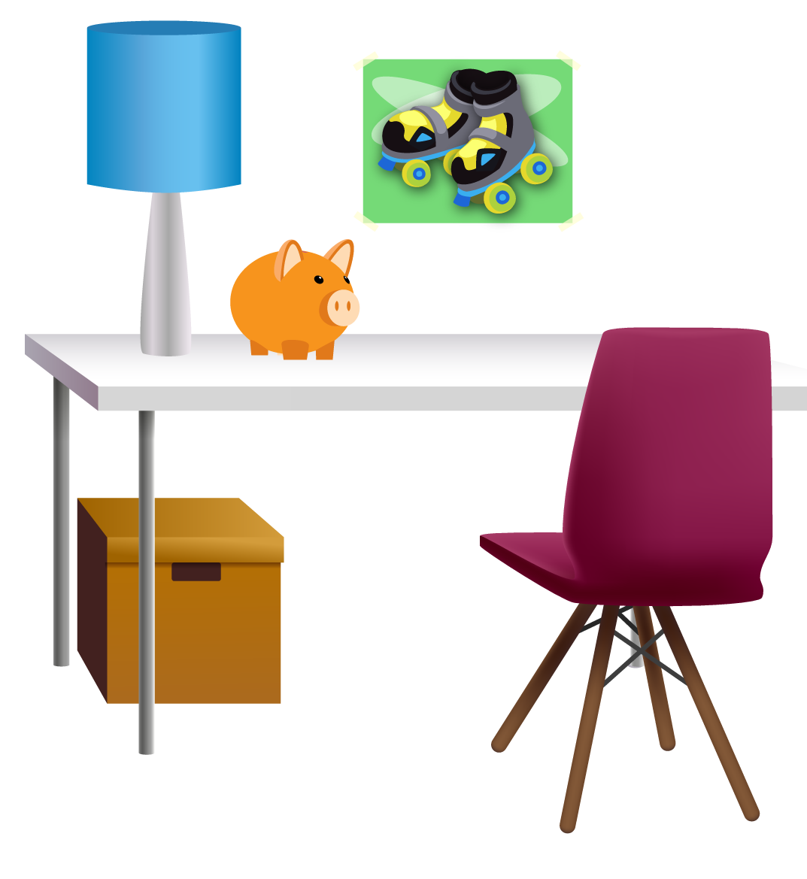
Picture It
Setting a savings goal should encourage Gabriella to save more of her money. If she keeps a photo or drawing
of her savings goal somewhere she can see it, that will remind her of why she’s saving.
Notes:
Say, “Setting a savings goal should encourage Gabriella to save more of her money.
If she keeps a photo or drawing of her savings goal somewhere she can see it, that will remind her of why she’s saving.”
Say, “Turn to a partner and see if you can come up with at least two other ways you help yourselves to remember goals you have set.”
Allow time for students to brainstorm and then ask a few pairs to share an idea.
If needed, provide additional examples, such as sharing their savings goal with a family member or friend and asking that person to remind them about it from time to time.

Slide 23
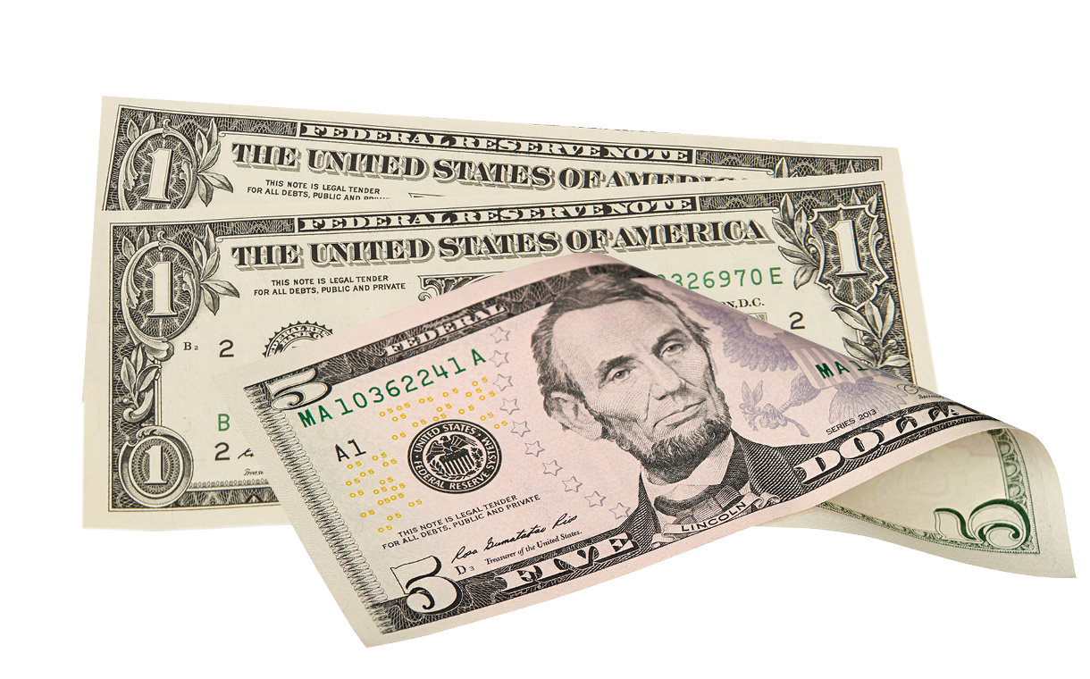
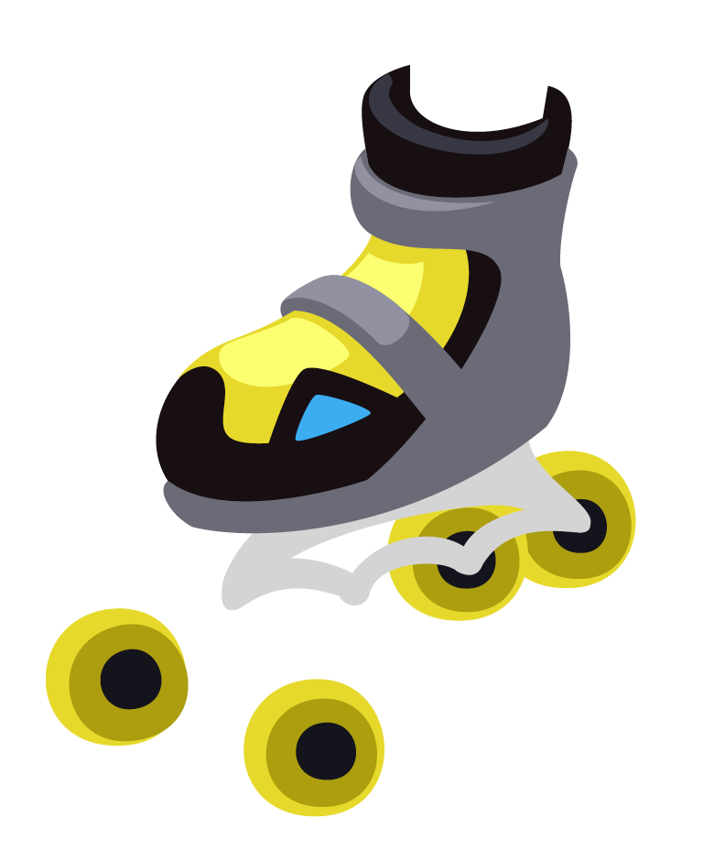
Another Savings Goal
Gabriella’s uncle told her that saving
for roller blades is a great idea. He also encouraged her to set some of her money aside for “a rainy day.”
He told her that some expenses can’t
be predicted like her skates breaking.
Notes:
Read, “Gabriella’s uncle told her that saving for roller skates is a great idea. He also encouraged her to set some of her money aside for ‘a rainy day.’
He told her that some expenses can’t be predicted like her skates breaking.”
Say, “Setting money aside for a ‘rainy day’ or an emergency fund is a really good idea. You never know when you will have an unexpected expense.
For example, a friend might invite you to do something that requires money to do, or something you have might break or get damaged.
Having money set aside for the unexpected can let you deal with these types of events.”

Slide 24
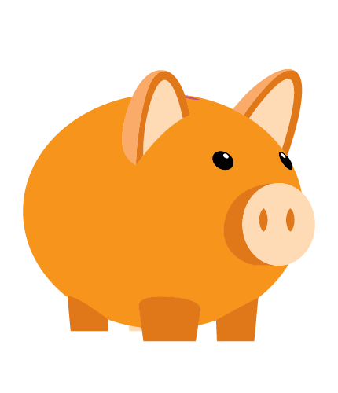
A Savings Plan
Help Gabriella develop a savings plan. If the roller skates she wants cost $45.87 and she wants to have $15.00 in her rainy day fund, how much money should Gabriella aim to save?
Notes:
Read, “Help Gabriella develop a savings plan. If the roller skates she wants cost $45.87 and she wants to have $15.00 in her rainy-day fund, how much money should Gabriella aim to save?”
Say, “Solve the problem on a scrap sheet of paper or with a calculator. When you think you have the answer, raise your hand.”

Slide 25

Will your solution work?
Notes:
Say, “Let’s see if one of you has the answer that will unlock Gabriella’s savings.”
Call on volunteers until the correct answer is given: 6-0-8-7 or $60.87.

Slide 26
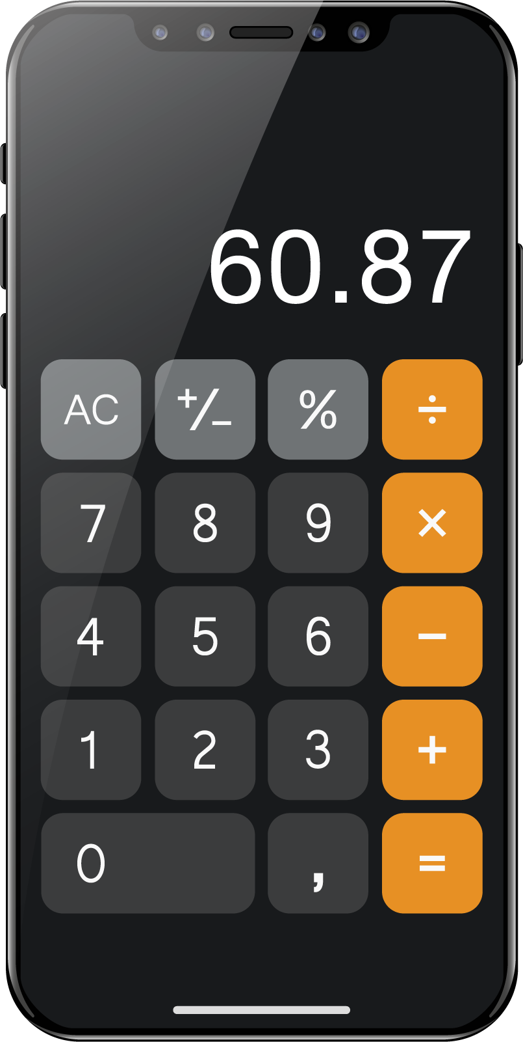
How Long
That’s right! Gabriella should plan to save $60.87. If she continues to get $8 a week in allowance, how long will it take her to save enough money to reach her goal?
Notes:
Read, “That’s right! Gabriella should plan to save $60.87. If she continues to get $8 a week in allowance, how long will it take her to save enough money to reach her goal?” Allow time for students to consider the problem and answer.
Say “It will take her eight weeks to save this much money. The less she saves each week, the longer it will take her to reach her goal.”
Say, “Once you know how much you need to save, you can create a savings plan. Savings plans include your savings goal, the amount you need to reach it, how long it will take you to reach your goal, and how much you should save on a regular basis to reach it.”

Slide 27
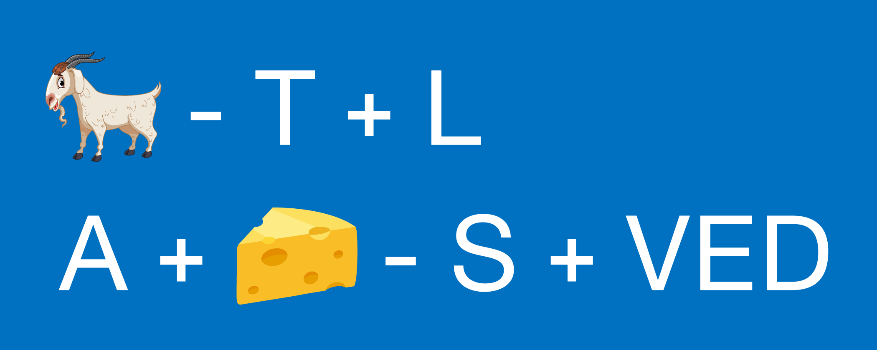
Did She Make It?
Solve this puzzle to find out how Gabriella did.
Notes:
Say, “Let’s see how Gabriella did. Who can solve this word equation? Once you think you know the answer, give me a thumbs up sign.”
Inform students that the puzzle is based on sounds. Ask them to try and spell the answer using the correct spelling.

Slide 28
What is your solution to this puzzle?
Notes:
Say, “Who thinks they know the answer?”
Call on a student to share their answer. Congratulate the first student to provide the correct answer: Goal achieved!

Slide 29
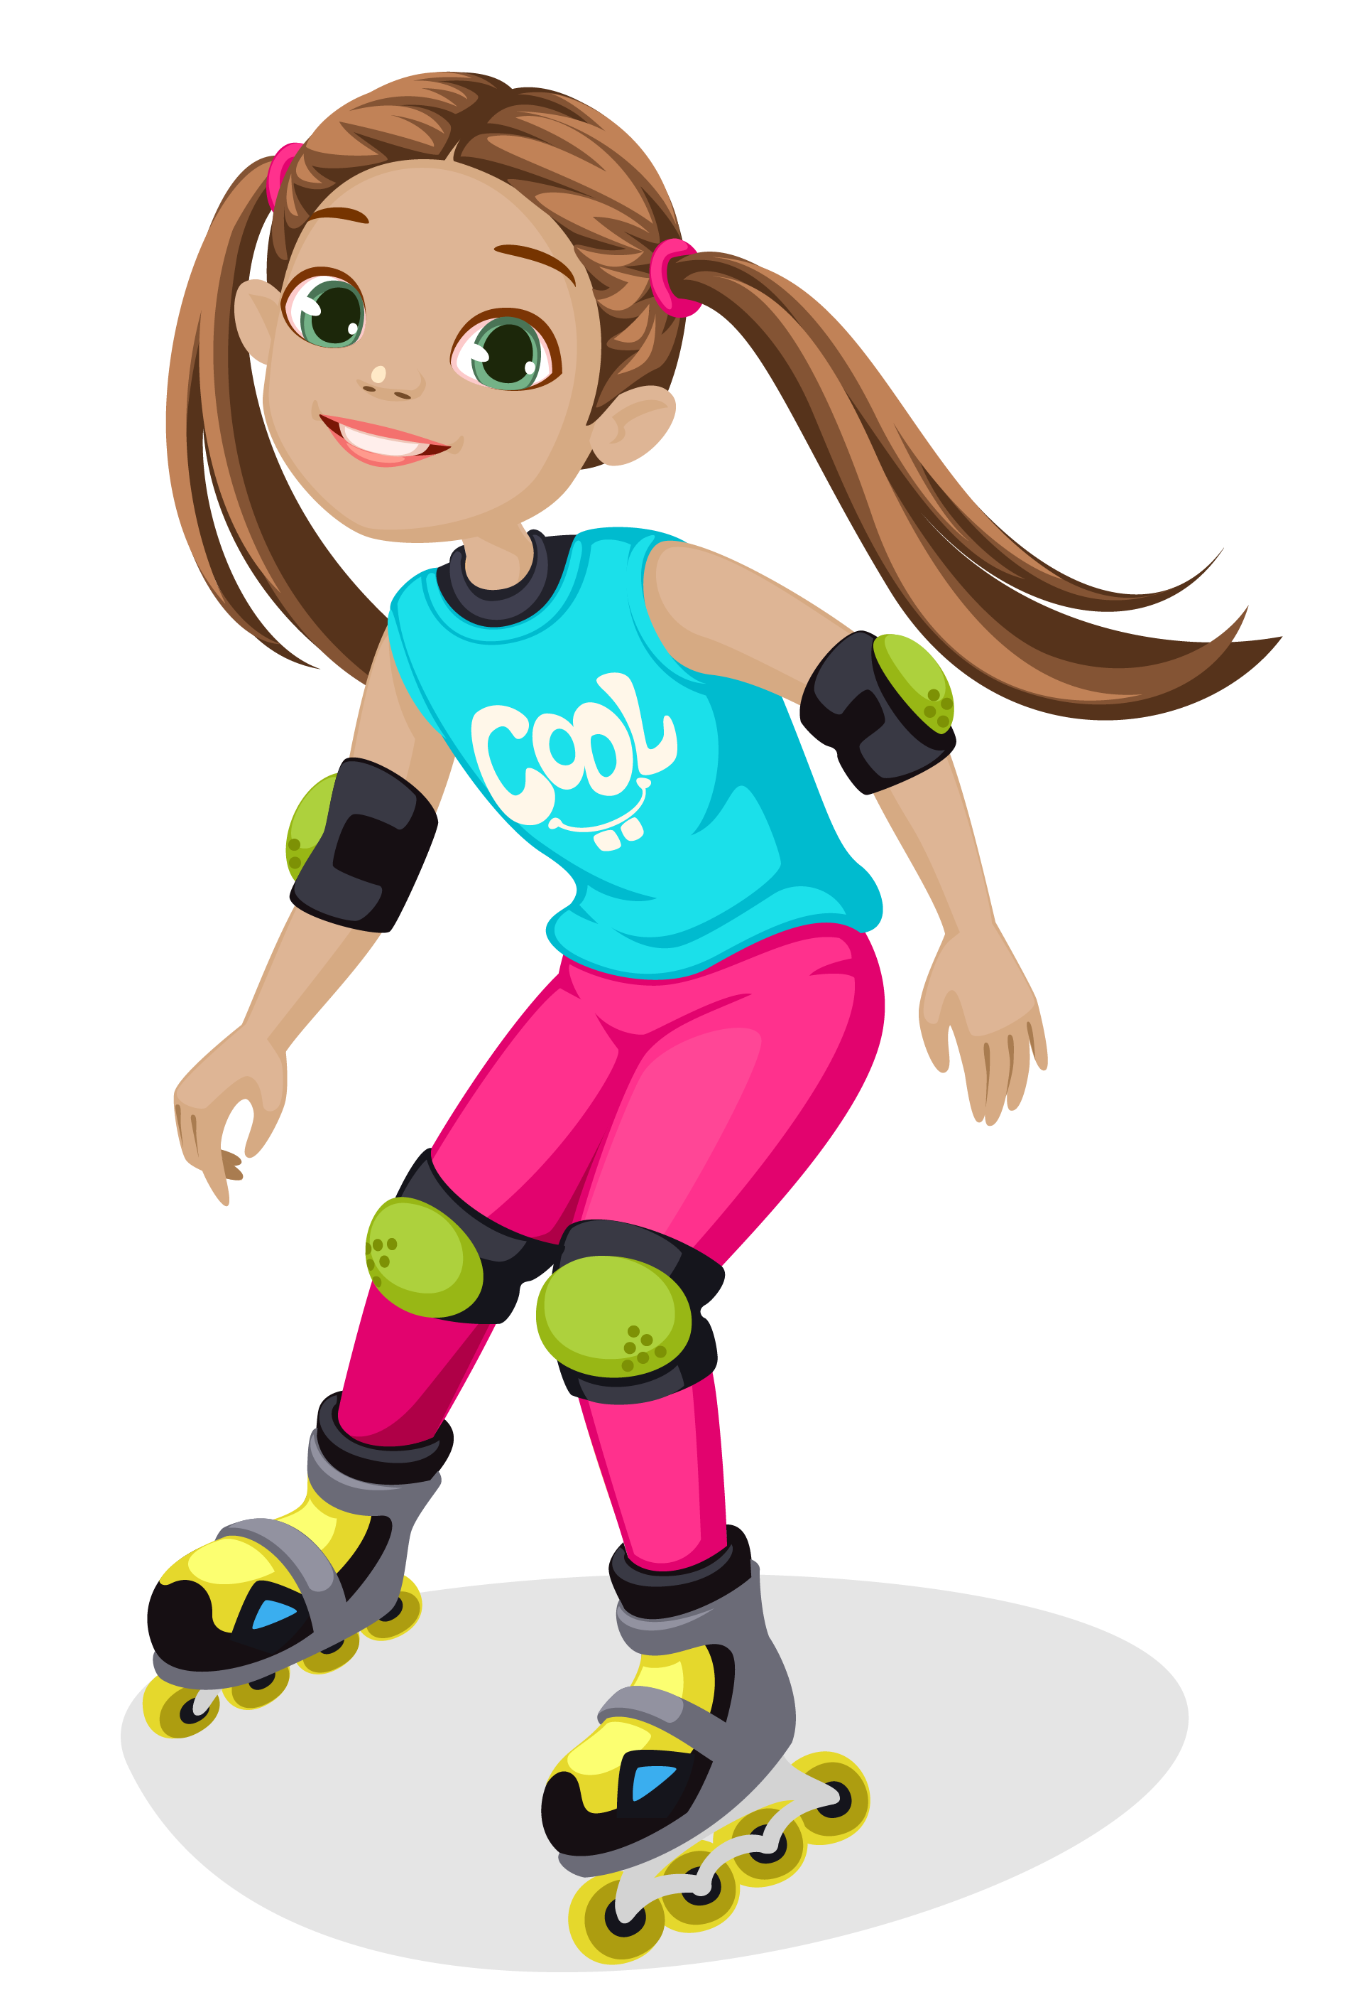
Well done!
You did a great job helping Gabriella unlock her savings!
Notes:
Read, “You did a great job helping Gabriella unlock her savings!”
Congratulate students for completing the breakout activity, and tell them that you hope they enjoyed it.

Slide 30

Do you have a savings goal? What is it?
Notes:
Say, “Before I leave, I’m curious. Do any of you have a savings goal like Gabriella?”
Call on several volunteers to share their savings goals.
Remind students that people often set very different savings goals.
For example, your savings goals are likely different than theirs or even those of your friends or family members.

Slide 31
THANK YOU!
Notes:
Thank the students for letting you come to their class and for paying attention and listening.
Remind students that it is important to set savings goals and keep the money they are saving in a safe place until they need to use it.
Tell them that you hope to see them opening a savings account or adding to it in your bank someday.

