Slide 1

Saving for a Rainy Day
Notes:
Introduce yourself to the class. Say, “Hello. My name is Ms./Mrs./Mx./Mr.”
(Students generally address adults in school settings as Ms./Mrs./Mx./Mr. Most use their last name.)
Say, “I’m here today as a volunteer from (Bank Name). Today we’re going to explore things people do with their money.”

Slide 2

Notes:
If you brought a piggy bank to use as an example, show it now along with the piggy bank on the slide.
Say, “Raise your hand if you can tell me what this is and how someone might use it.”
Accept several student answers. Confirm that it is a piggy bank with money inside.
Say, “People put money in piggy banks and other containers that they are saving.”
Ask, “Why do you think people put the money they are saving into a piggy bank or other container?”
Call on several students to share their answers. Share additional reasons and examples, as desired, to ensure student understanding.
• Keeping money in a piggy bank or a jar is safer than keeping it in other places.
• Money left in a pocket, for example, might be lost in the wash.
• If you set your money down in your room, it might get lost or mixed in with other things.
Say, “Having a special place to keep your money is a great idea.”

Slide 3

Have you ever saved money in a piggy bank or other safe place?
Notes:
Ask, “Have you ever saved money in a piggy bank or another safe place?”
Invite several students to share where they have saved money and why.

Slide 4


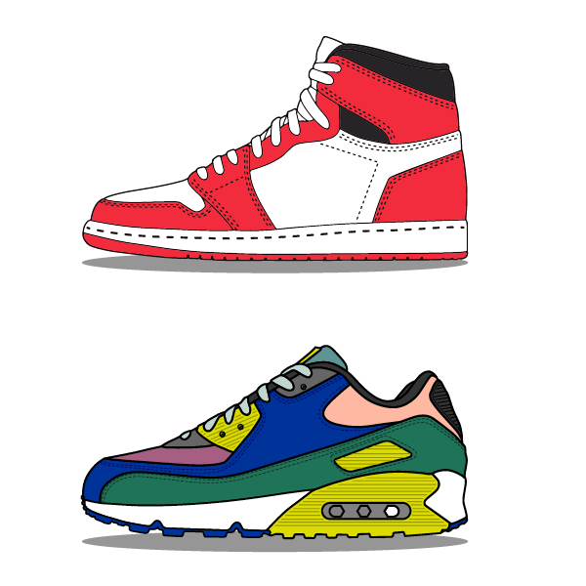
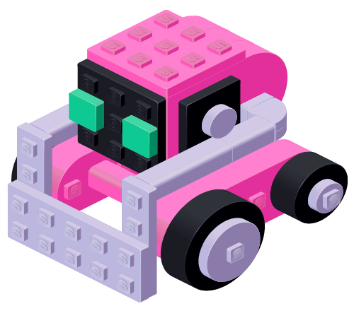


Examples of Savings Goals
Notes:
Say, “I just heard some of you share what I like to call a ‘savings goal’ — when you save your money to try, buy, or do something.”
Say, “Here are some examples of different savings goals.”
Ask, “Are any of these savings goals you might have? If not, who do you think might want to save for these things?”
Share potential reasons people might save for one or more of the examples, such as:
• Someone who loves to play baseball might save for a new baseball glove or a new bat.
• If you like to play video games, you might save money for a new game, controller, or even a new console.
• Perhaps you want a pair of shoes that your family doesn’t want to buy, so you might save money to get them yourself.
• Maybe you love playing with a certain type of toy, like LEGO® bricks*, and you want to buy more.
• Savings goals aren’t just for things. Going to an amusement park, movie, or concert could be a savings goal.
Reinforce that people often have very different savings goals.
Say, “Your savings goal might be different than your friend’s savings goal, and that is okay. In fact, most people will have different savings
goals because their interests are different. Your savings goals often change over time. My savings goals now as an adult, for example, are
very different than they were at your age.”

Slide 5

Why are they called savings GOALS?
Notes:
Ask, “Does anyone know why we call these savings goals?”
Accept several student answers then reinforce that savings goals give us something to aim for and reach — just like in sports like basketball, soccer,
hockey, football, etc.

Slide 6
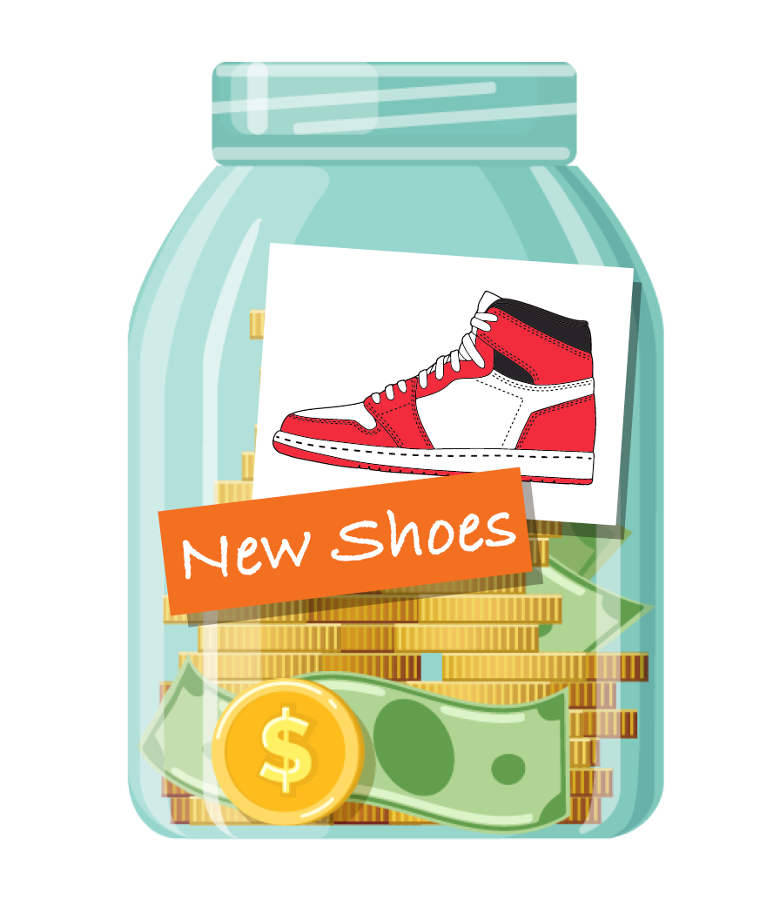
It is a good idea to name your savings goals and remind yourself of them.
Notes:
Say, “Naming our savings goals and reminding ourselves of them can help us stay focused on our goals."

Slide 7
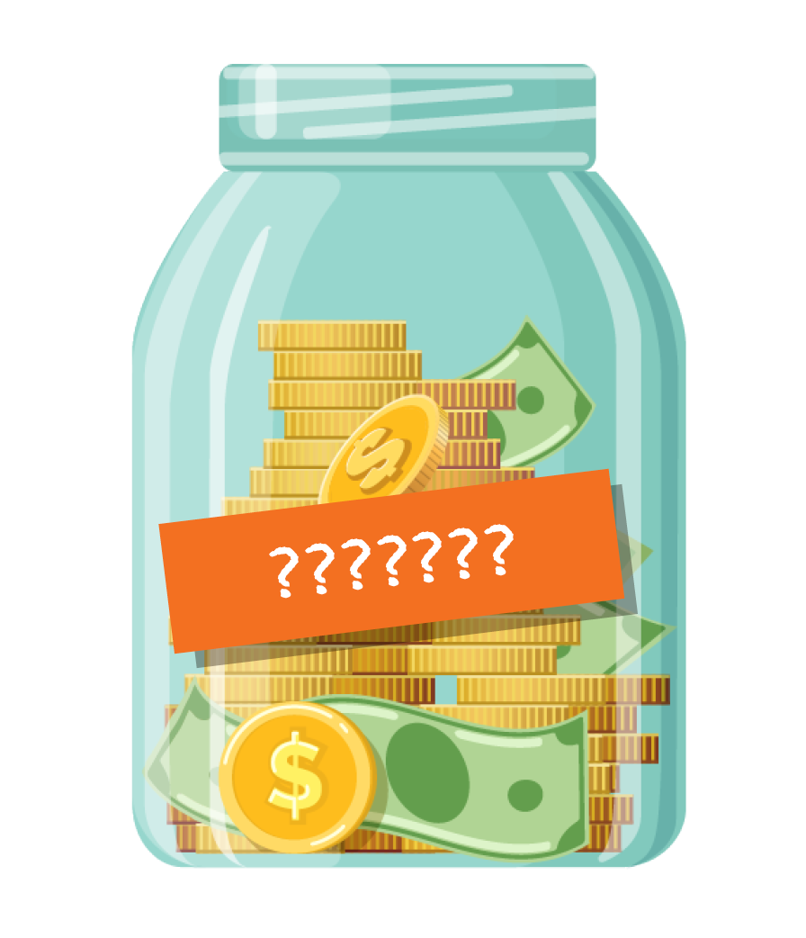
What are YOUR savings goals?
Notes:
Ask, “What are some savings goals you might set?”
If time allows, distribute a My Personal Savings Goal activity sheet to each student and invite them to draw a picture or write about a personal savings
goal. Invite students to share the savings goals they illustrated or wrote about.

Slide 8

Rainy Days Ahead
Notes:
Ask, “Does anyone know if it is going to rain later today or tomorrow?”
If using them, point out your “rainy day” gear. For example, say, “I’m wearing my trusty poncho, and I have my umbrella ready in case I need it."

Slide 9

Saving for a “Rainy Day”
Notes:
Say, “If you ask some people what they are saving their money for, they might tell you they are saving for a rainy day. In fact, they might even
call it their rainy day fund. This is just a saying, though. It doesn’t mean they are saving for an actual rainy day."

Slide 10
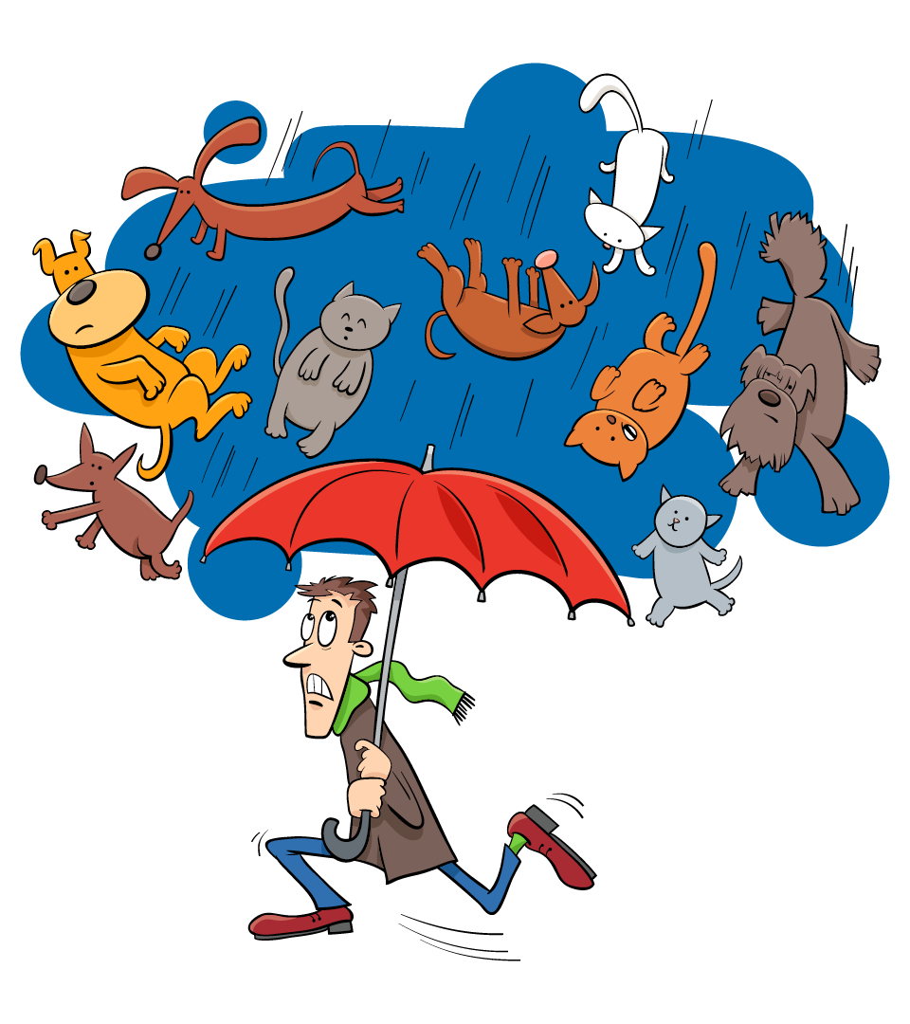
“It is raining cats and dogs outside!”
Notes:
Ask, “Have you ever heard someone say that it is raining cats and dogs outside?”
Say, “When people use this saying, they don’t mean cats and dogs are actually falling from the sky, do they? No. They mean, it is raining
really hard."

Slide 11
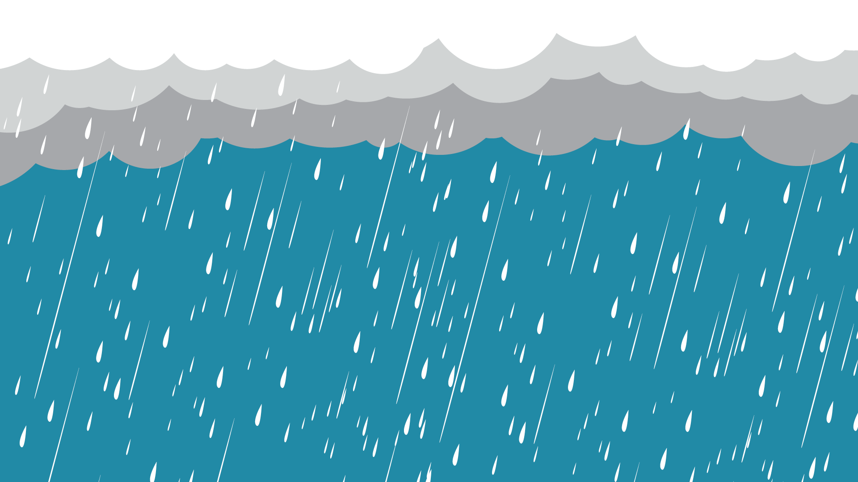


Saving for a “Rainy Day”
Notes:
Say, “So, when people say they are saving for a rainy day they aren’t saving for umbrellas or rain boots. Instead, what they mean is that they
are saving for something unexpected.”

Slide 12
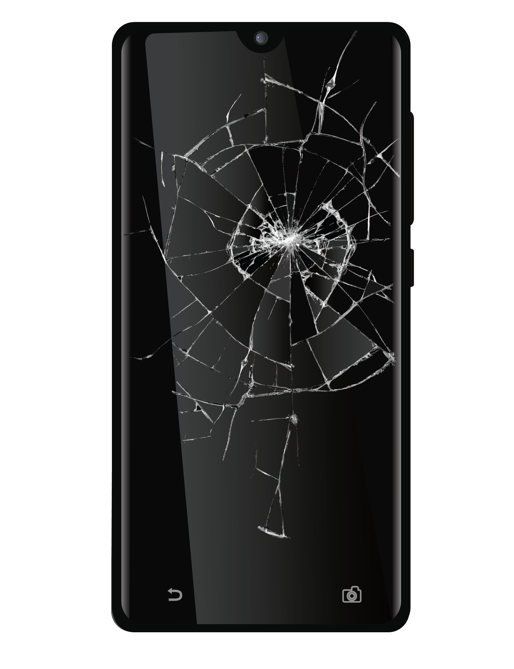
A “Rainy Day”
Example
Notes:
Ask, “Here’s an example of what could be considered a ‘rainy day’ or an unexpected event. What do you think this is showing?”
Accept student responses and clarify, as needed, that this shows a cell phone with a broken screen.
Say, “People accidentally drop their phones and break the screen, but they can’t predict when — or where — that will happen.”
Explain that if the screen on your cell phone shatters, you will need to pay to fix the screen or buy a new phone.
Say, “People don’t plan to drop their phone, so needing to fix it would be an unexpected cost.”

Slide 13
Use money from your rainy day fund to fix the phone.
Notes:
Say, “If a person has a rainy day fund, they can use that money to pay for these unexpected costs. But what would happen if they don’t
have a rainy day fund?”
Ask, “What would happen if someone didn’t have a rainy day fund?”
Accept student responses and share additional reasons, such as:
• Use money being saved for something else.
• Not use the phone until they save up the money to fix it.
• Borrow the money to fix it and then earn more money to pay that back.
Say, “Just like it is a good idea for adults to have a rainy day fund, kids can save for a rainy day, too.”
Share examples of reasons young people might save for a “rainy day” such as fixing or replacing something that is damaged. If possible, share a
personal anecdote or story. Examples might include:
• Bike gets a flat tire and needs to be replaced
• Dog chews your shoes and you need a new pair
• Lose something you borrowed from a friend or relative and need to replace it
• Video game controller stops working and you need a new one

Slide 14
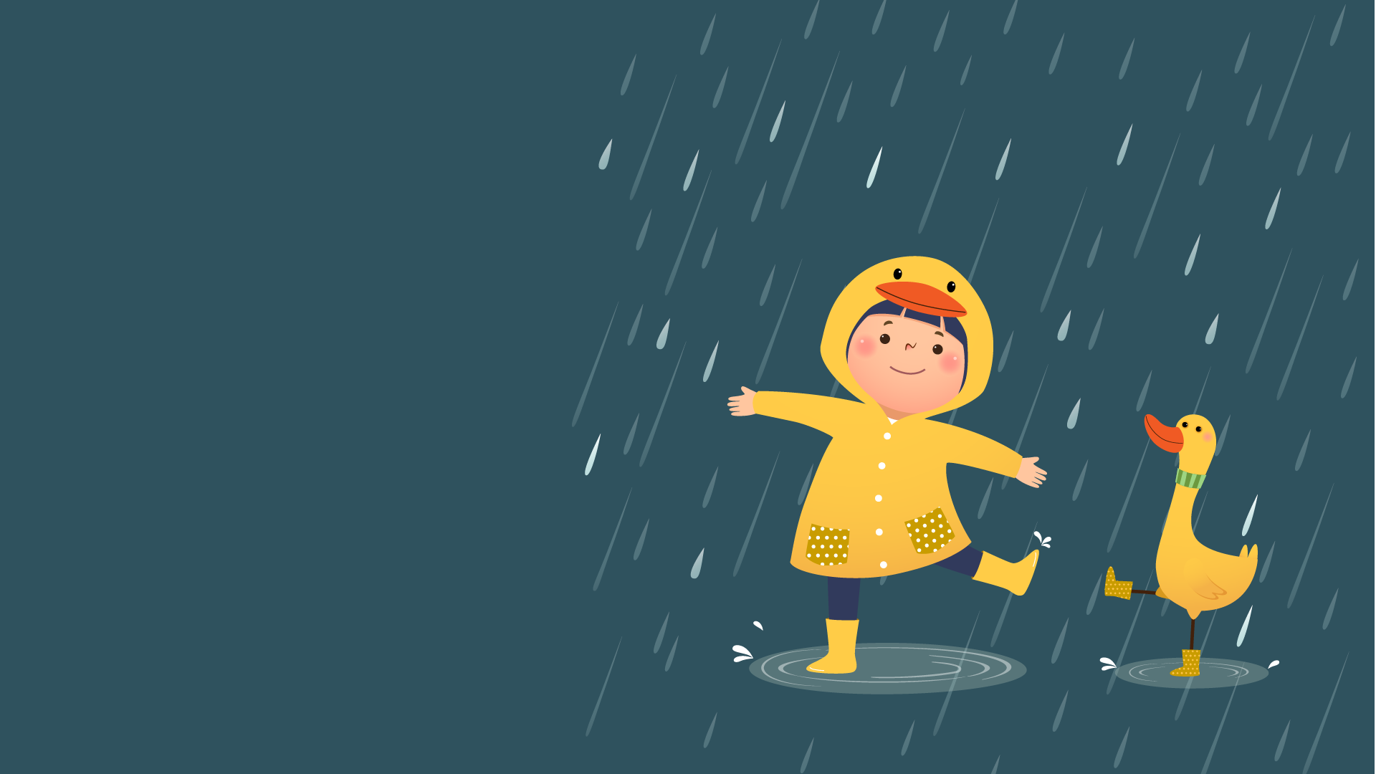
Not all unexpected events are bad
Notes:
Say, “Rainy days aren’t all bad. They can be good, too. Without rain, lots of flowers and food wouldn’t grow."

Slide 15
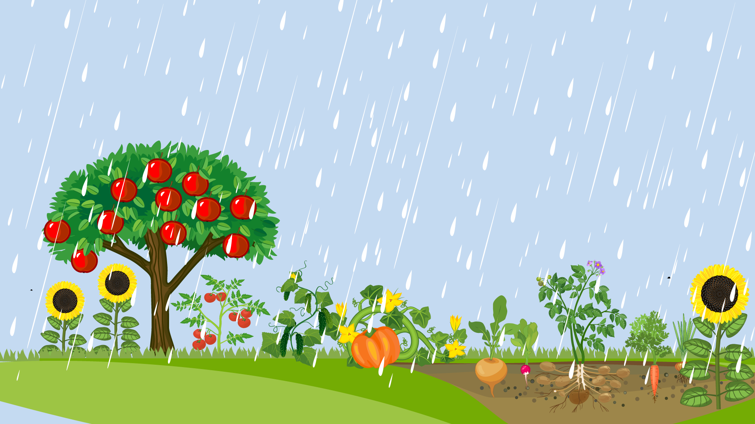
Not all unexpected events are bad
Notes:
Say, “Sometimes you might want money to pay for something unexpected that is good. For example, a friend might invite you to go
somewhere that will cost money. You might decide you want to buy a gift for a friend or a loved one. These are other ways to use
money in your rainy day fund."

Slide 16
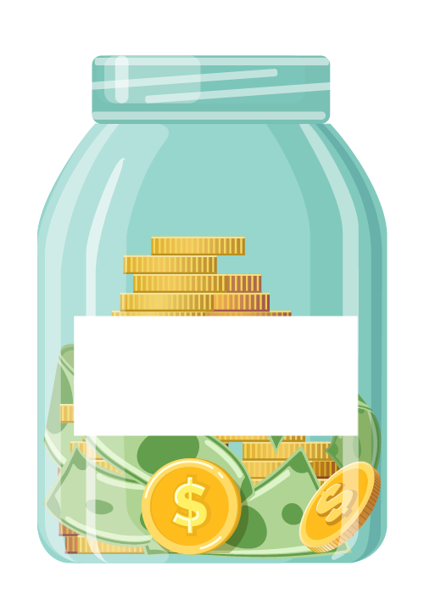
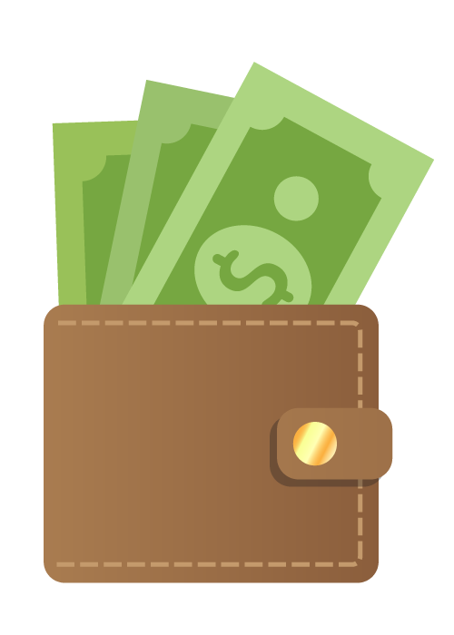
Divide Your Money
Giving
Notes:
Say, “When you are saving for more than one reason, it is a good idea to divide your money. You should also keep your spending money
separate from the money you are saving. If you set money aside to give to others, this can also go in a different place.”

Slide 17
Money Jars Activity
Notes:
Say, “You don’t need anything fancy or even to spend any money to separate your money. You can do it by simply using containers you have
at home.”

Slide 18
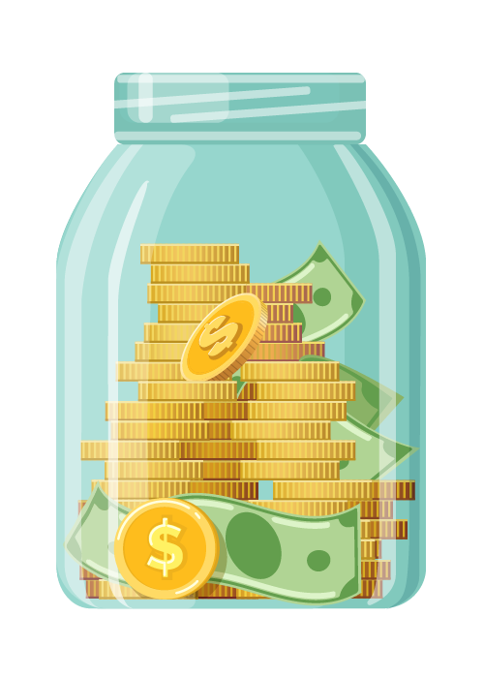
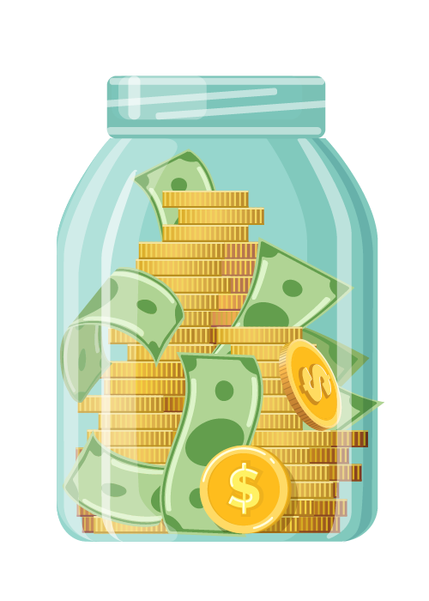
Making Money Jars
Fill in the blanks with your savings goal and what you usually spend money to buy.
Color the labels.
Cut them out and attach them to jars at home.
Notes:
Say, “We’re going to create labels that you can use once you locate jars or other containers at home.”
Distribute a copy of the Jar Wraps Activity Sheets to each student. Point out the different labels and explain how each might be used:
• Savings goal: Something you plan to buy or do in the future
• Rainy day fund: Money for an unexpected event
• Spending: Ordinary purchases
• Giving: Money you plan to donate or share with others in some way
Direct students to fill in the blank on the savings goal label with a savings goal they identified earlier or another one. If time allows, students can color
and cut out the labels. If not, this can be done later or taken home to complete. If you have a set that you made ahead of time to demonstrate, show
them to the students as an example of what the finished project will look like.

Slide 19
Have you ever heard of a bank?
Notes:
Ask, “Have you ever heard of a bank?”
Say, “Another place where many people keep their money safe is at a bank. Money in the bank isn’t just safe from things like being stolen or
lost. When you keep money at home in an easy-to-access location, you might be tempted to spend it rather than save it.”
Say, “If you are interested in keeping your money in a savings account at a bank, the best place to start is by talking to your parent or
guardian about your options."

Slide 20

THANK YOU!
Notes:
Thank the students for letting you come to their class and for paying attention and listening.
Remind students that no matter what they plan to do with their money it is always a good idea to keep it somewhere safe.
Let them know that you hope to see them someday — perhaps bringing the money they have saved to the bank.

